Slide 2
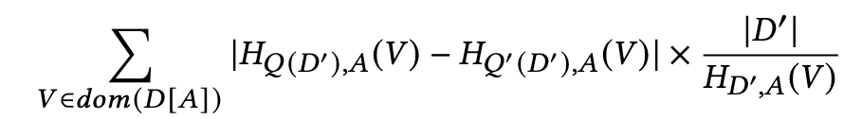
Private Dataset D
Query Q (aggregation)
Constraints
Epsilon
K
Refinement Algorithm
Q’
Views generation using predicates
Views filtering
Choose the best View
attr1
1. The view must not be defined by attr1
* 2. |Q(V)| > CONST
3. 50%-argmin (Noisy MI_factor(V, attr1 ))
Find the top-K scored attributes and generate noisy histograms
attr2
Views filtering
Choose the Best View
...
attr-n
Views filtering
Choose the Best View
Constraint attr
Generate noisy histogram

Slide 3
Input: attr, predicate space, private dataset, query, constraints, refined query, budget
Output: set of histograms for explaining attr
Algorithm: use the score function of the EM containing mutual (HD - MID)*|Q(V)| to find the best histogram, where V is defined by the predicate

Slide 4
For each attr not in constraint group Choose the Best View
Find the top-K scored attributes and generate noisy histograms
Private Dataset D
Query Q (aggregation)
Constraints
Epsilon
K
Refinement Algorithm
Q’
Views generation using predicates
Option1: (HD - MID) * |Q(p(D))
Option 2: (HD / Normalized MID) * |Q(p(D))| / |D|
Constraint attr
Generate noisy histogram
MID=
HD =

Slide 5
Open Issues
Normalization
MI
|Q(V)| / |D|

Slide 6
For each attr not in constraint group Choose the Best View
Find the top-K scored attributes and generate noisy histograms
Private Dataset D
Query Q (aggregation)
Constraints
Epsilon
K
Refinement Algorithm
Q’
Views generation using predicates
Utility = (HD - MID) * |Q(p(D))| * |Q’(p(D))| ›$
Constraint attr
Generate noisy histogram
View = p(D) = D’
MID=
HD =

Slide 7
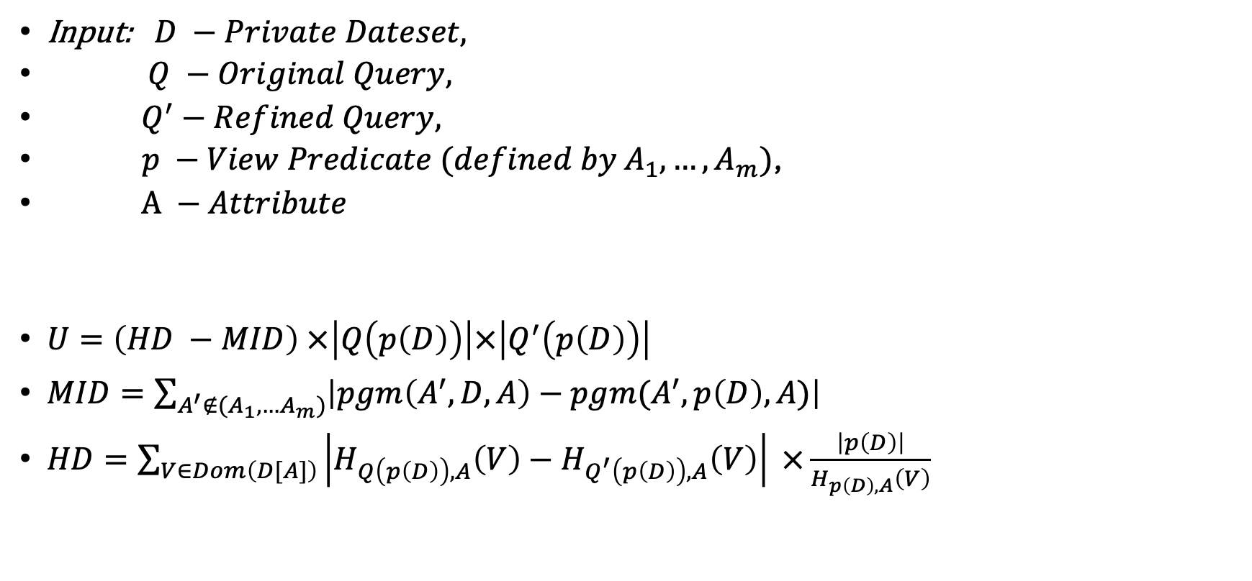
Utility Function
Input: $D −Private Dateset,$
$Q −Original Query,$
$Q^{′}−Refined Query,$
$p −View Predicate (defined by A_{1}, …,A_{m})$,
$A −Attribute$
$U=\left(HD −MID\right) ×\left|Q\left(p\left(D\right)\right)\right|×\left|Q^{′}\left(p\left(D\right)\right)\right|$
$MID=\sum_{A^{′}∉(A_{1},…A_{m})}{\left|pgm\left(A^{′},D,A\right)−pgm(A^{′}, p\left(D\right), A)\right|}$
$HD=\sum_{V∈Dom\left(D[A]\right)}{\left|H_{Q\left(p\left(D\right)\right),A}\left(V\right)−H_{Q^{′}\left(p\left(D\right)\right),A}\left(V\right)\right| ×\frac{\left|p\left(D\right)\right|}{H_{p\left(D\right),A}\left(V\right)}}$

Slide 8
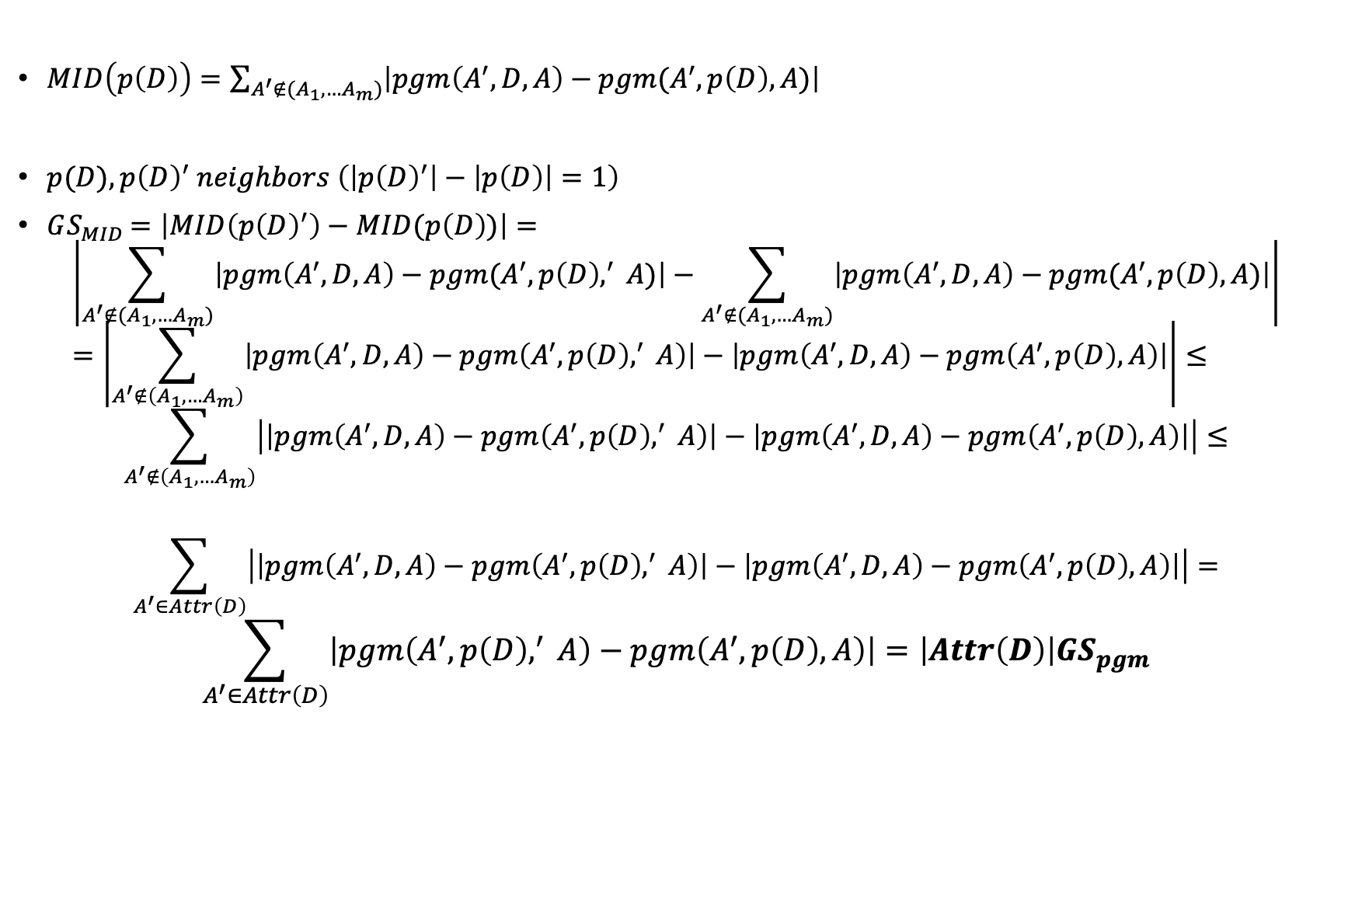
Sensitivity
$MID\left(p\left(D\right)\right)=\sum_{A^{′}∉(A_{1},…A_{m})}{\left|pgm\left(A^{′},D,A\right)−pgm(A^{′}, p\left(D\right), A)\right|}$
$p(D), {p\left(D\right)}^{′} neighbors \left(\left|{p\left(D\right)}^{′}\right|−\left|p\left(D\right)\right|=1\right)$
$GS_{MID}=\left|MID\left(p{\left(D\right)}^{′}\right)−MID(p\left(D\right))\right|=$
$$\left|\sum_{A^{′}∉(A_{1},…A_{m})}{\left|pgm\left(A^{′},D,A\right)−pgm(A^{′}, p\left(D\right),^{′} A)\right|}−\sum_{A^{′}∉(A_{1},…A_{m})}{\left|pgm\left(A^{′},D,A\right)−pgm(A^{′}, p\left(D\right), A)\right|}\right|=\left|\sum_{A^{′}∉\left(A_{1},…A_{m}\right)}{\left|pgm\left(A^{′},D,A\right)−pgm\left(A^{′}, p\left(D\right),^{′} A\right)\right|−\left|pgm\left(A^{′},D,A\right)−pgm\left(A^{′}, p\left(D\right), A\right)\right|}\right|≤$$
$$\sum_{A^{′}∉\left(A_{1},…A_{m}\right)}{\left|\left|pgm\left(A^{′},D,A\right)−pgm\left(A^{′}, p\left(D\right),^{′} A\right)\right|−\left|pgm\left(A^{′},D,A\right)−pgm\left(A^{′}, p\left(D\right), A\right)\right|\right|}≤$$
$$\sum_{A^{′}∈Attr\left(D\right)}{\left|\left|pgm\left(A^{′},D,A\right)−pgm\left(A^{′}, p\left(D\right),^{′} A\right)\right|−\left|pgm\left(A^{′},D,A\right)−pgm\left(A^{′}, p\left(D\right), A\right)\right|\right|}=$$
$$\sum_{A^{′}∈Attr\left(D\right)}{\left|pgm\left(A^{′}, p\left(D\right),^{′} A\right)−pgm\left(A^{′}, p\left(D\right), A\right)\right|=\left|Attr\left(D\right)\right|GS_{pgm}}$$

Slide 9
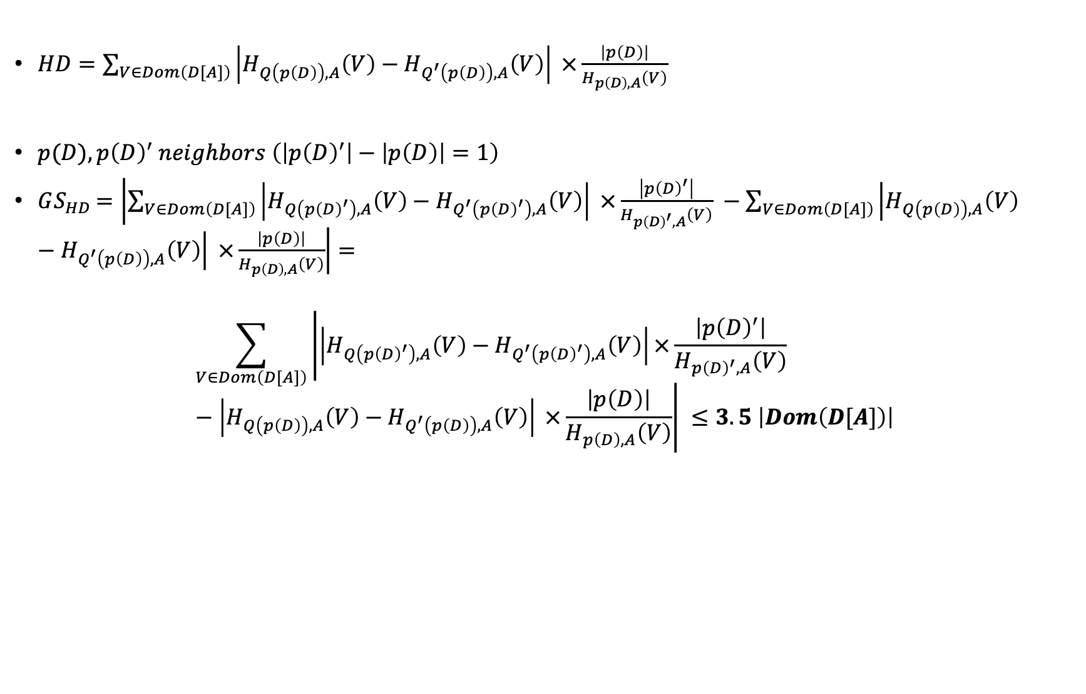
$HD=\sum_{V∈Dom\left(D[A]\right)}{\left|H_{Q\left(p\left(D\right)\right),A}\left(V\right)−H_{Q^{′}\left(p\left(D\right)\right),A}\left(V\right)\right| ×\frac{\left|p\left(D\right)\right|}{H_{p\left(D\right),A}\left(V\right)}}$
$p(D), {p\left(D\right)}^{′} neighbors \left(\left|{p\left(D\right)}^{′}\right|−\left|p\left(D\right)\right|=1\right)$
$GS_{HD}=\left|\sum_{V∈Dom\left(D[A]\right)}{\left|H_{Q\left(p{\left(D\right)}^{′}\right),A}\left(V\right)−H_{Q^{′}\left(p{\left(D\right)}^{′}\right),A}\left(V\right)\right| ×\frac{\left|p{\left(D\right)}^{′}\right|}{H_{p{\left(D\right)}^{′},A}\left(V\right)}} −\sum_{V∈Dom\left(D[A]\right)}{\left|H_{Q\left(p\left(D\right)\right),A}\left(V\right)−H_{Q^{′}\left(p\left(D\right)\right),A}\left(V\right)\right| ×\frac{\left|p\left(D\right)\right|}{H_{p\left(D\right),A}\left(V\right)}}\right|=$
$$\sum_{V∈Dom\left(D[A]\right)}{\left|\left|H_{Q\left(p{\left(D\right)}^{′}\right),A}\left(V\right)−H_{Q^{′}\left(p{\left(D\right)}^{′}\right),A}\left(V\right)\right|×\frac{\left|p{\left(D\right)}^{′}\right|}{H_{p{\left(D\right)}^{′},A}\left(V\right)}−\left|H_{Q\left(p\left(D\right)\right),A}\left(V\right)−H_{Q^{′}\left(p\left(D\right)\right),A}\left(V\right)\right| ×\frac{\left|p\left(D\right)\right|}{H_{p\left(D\right),A}\left(V\right)}\right| }≤3.5 \left|Dom\left(D[A]\right)\right|$$

Slide 10
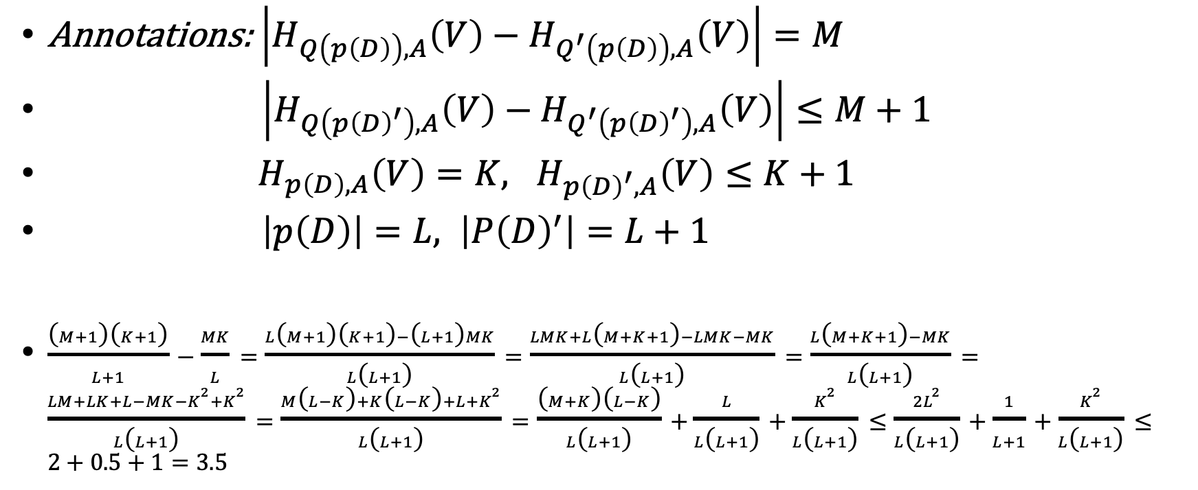
Annotations: $\left|H_{Q\left(p\left(D\right)\right),A}\left(V\right)−H_{Q^{′}\left(p\left(D\right)\right),A}\left(V\right)\right|=M$
$\left|H_{Q\left(p{\left(D\right)}^{′}\right),A}\left(V\right)−H_{Q^{′}\left(p{\left(D\right)}^{′}\right),A}\left(V\right)\right|≤M+1$
$H_{p\left(D\right),A}\left(V\right)=K, H_{p{\left(D\right)}^{′},A}\left(V\right)≤K+1$
$\left|p\left(D\right)\right|=L, \left|P{\left(D\right)}^{′}\right|=L+1$
$\frac{\left(M+1\right)\left(K+1\right)}{L+1}−\frac{MK}{L}=\frac{L\left(M+1\right)\left(K+1\right)−\left(L+1\right)MK}{L\left(L+1\right)}=\frac{LMK+L\left(M+K+1\right)−LMK−MK}{L\left(L+1\right)}=\frac{L\left(M+K+1\right)−MK}{L\left(L+1\right)}=\frac{LM+LK+L−MK−K^{2}+K^{2}}{L\left(L+1\right)}=\frac{M\left(L−K\right)+K\left(L−K\right)+L+K^{2}}{L\left(L+1\right)}=\frac{\left(M+K\right)\left(L−K\right)}{L\left(L+1\right)}+\frac{L}{L\left(L+1\right)}+\frac{K^{2}}{L\left(L+1\right)}≤\frac{2L^{2}}{L\left(L+1\right)}+\frac{1}{L+1}+\frac{K^{2}}{L\left(L+1\right)}≤2+0.5+1=3.5$

Slide 11
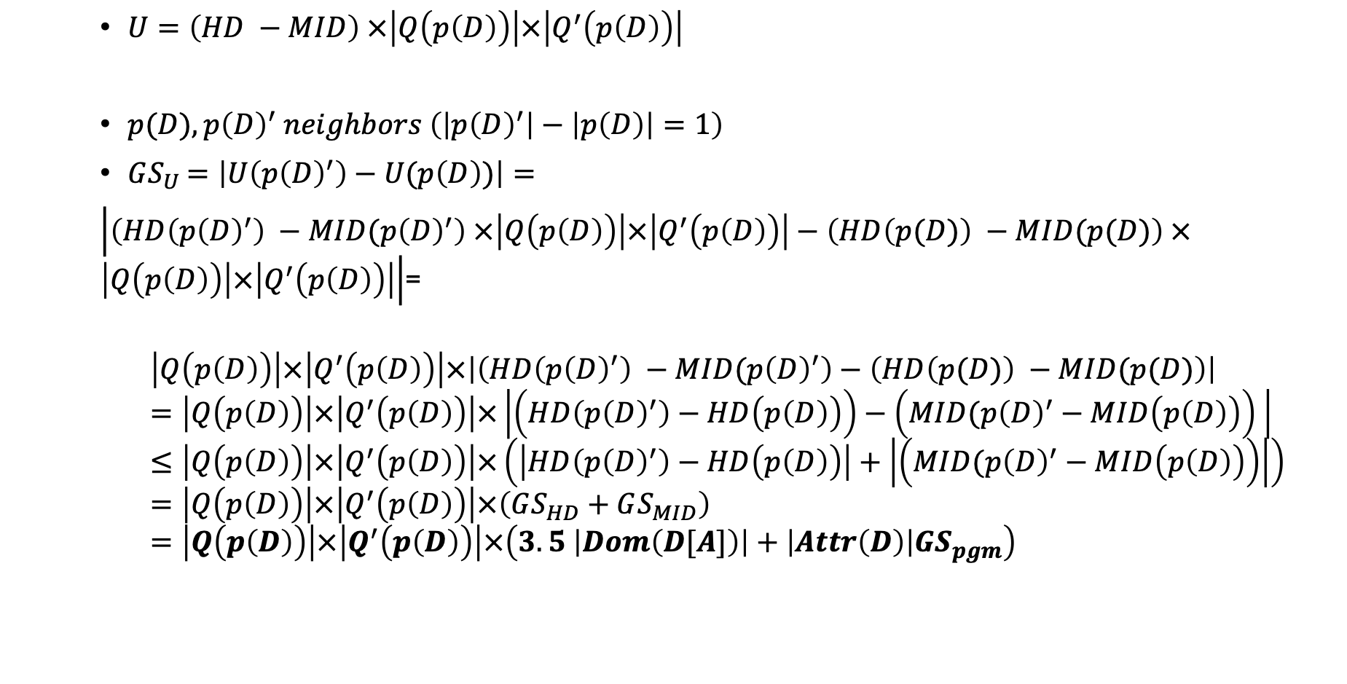
$U=\left(HD −MID\right) ×\left|Q\left(p\left(D\right)\right)\right|×\left|Q^{′}\left(p\left(D\right)\right)\right|$
$p(D), {p\left(D\right)}^{′} neighbors \left(\left|{p\left(D\right)}^{′}\right|−\left|p\left(D\right)\right|=1\right)$
$GS_{U}=\left|U\left(p{\left(D\right)}^{′}\right)−U(p\left(D\right))\right|=$
$\left|\left(HD\left(p{\left(D\right)}^{′}\right) −MID(p{\left(D\right)}^{′}\right) ×\left|Q\left(p\left(D\right)\right)\right|×\left|Q^{′}\left(p\left(D\right)\right)\right|−\left(HD\left(p(D)\right) −MID(p(D)\right) ×\left|Q\left(p\left(D\right)\right)\right|×\left|Q^{′}\left(p\left(D\right)\right)\right|\right|$=
$$\left|Q\left(p\left(D\right)\right)\right|×\left|Q^{′}\left(p\left(D\right)\right)\right|×\left|\left(HD\left(p{\left(D\right)}^{′}\right) −MID(p{\left(D\right)}^{′}\right)−\left(HD\left(p(D)\right) −MID(p(D)\right)\right|=\left|Q\left(p\left(D\right)\right)\right|×\left|Q^{′}\left(p\left(D\right)\right)\right|×\left|\left(HD\left(p{\left(D\right)}^{′}\right)−HD\left(p\left(D\right)\right)\right)−\left(MID(p{\left(D\right)}^{′}−MID\left(p\left(D\right)\right)\right) \right|≤\left|Q\left(p\left(D\right)\right)\right|×\left|Q^{′}\left(p\left(D\right)\right)\right|×\left(\left|HD\left(p{\left(D\right)}^{′}\right)−HD\left(p\left(D\right)\right)\right|+\left|\left(MID(p{\left(D\right)}^{′}−MID\left(p\left(D\right)\right)\right)\right|\right)=\left|Q\left(p\left(D\right)\right)\right|×\left|Q^{′}\left(p\left(D\right)\right)\right|×\left(GS_{HD}+GS_{MID}\right)=\left|Q\left(p\left(D\right)\right)\right|×\left|Q^{′}\left(p\left(D\right)\right)\right|×\left(3.5 \left|Dom\left(D[A]\right)\right|+\left|Attr\left(D\right)\right|GS_{pgm}\right)$$

Slide 12
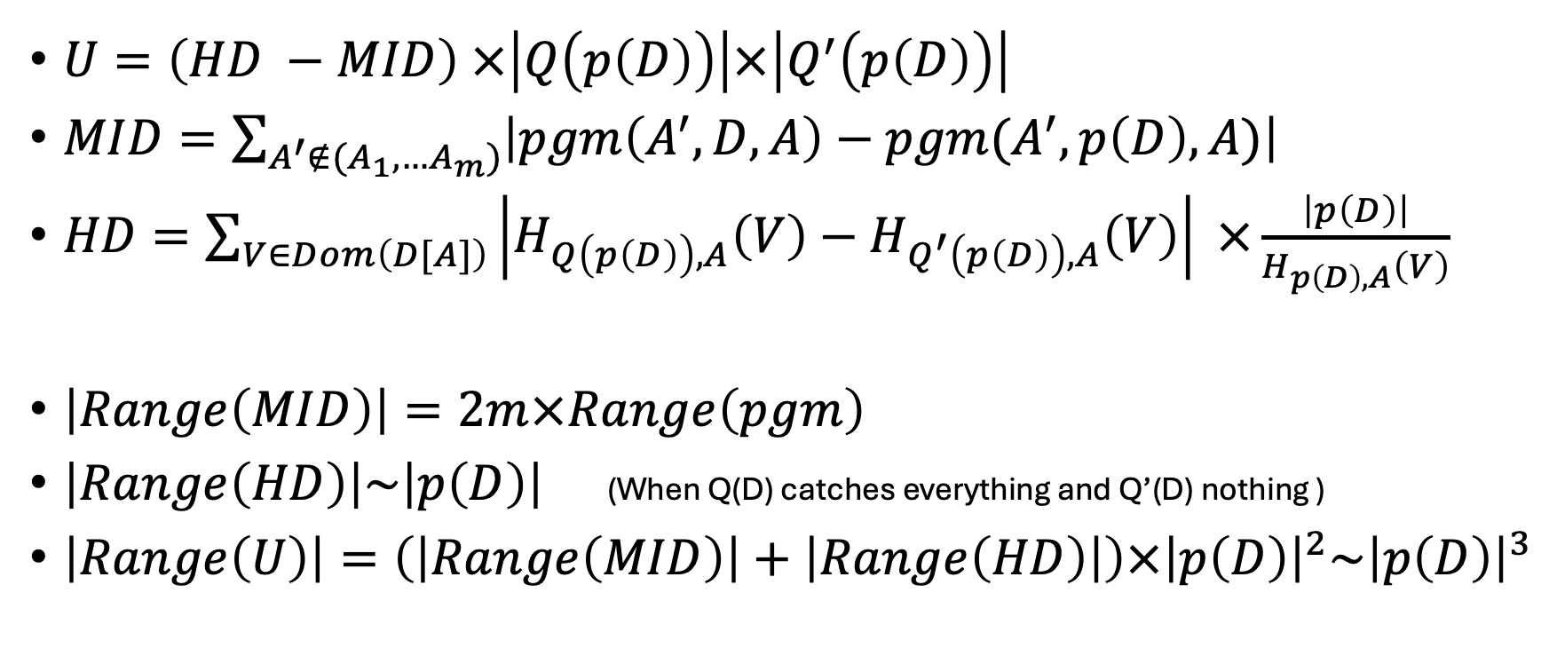
Range
$U=\left(HD −MID\right) ×\left|Q\left(p\left(D\right)\right)\right|×\left|Q^{′}\left(p\left(D\right)\right)\right|$
$MID=\sum_{A^{′}∉(A_{1},…A_{m})}{\left|pgm\left(A^{′},D,A\right)−pgm(A^{′}, p\left(D\right), A)\right|}$
$HD=\sum_{V∈Dom\left(D[A]\right)}{\left|H_{Q\left(p\left(D\right)\right),A}\left(V\right)−H_{Q^{′}\left(p\left(D\right)\right),A}\left(V\right)\right| ×\frac{\left|p\left(D\right)\right|}{H_{p\left(D\right),A}\left(V\right)}}$
$\left|Range\left(MID\right)\right|=2m×Range\left(pgm\right)$
$\left|Range\left(HD\right)\right|\sim \left|p\left(D\right)\right|$ (When Q(D) catches everything and Q’(D) nothing )
$\left|Range\left(U\right)\right|=\left(\left|Range\left(MID\right)\right|+\left|Range\left(HD\right)\right|\right)×{\left|p\left(D\right)\right|}^{2}\sim {\left|p\left(D\right)\right|}^{3}$

Slide 13
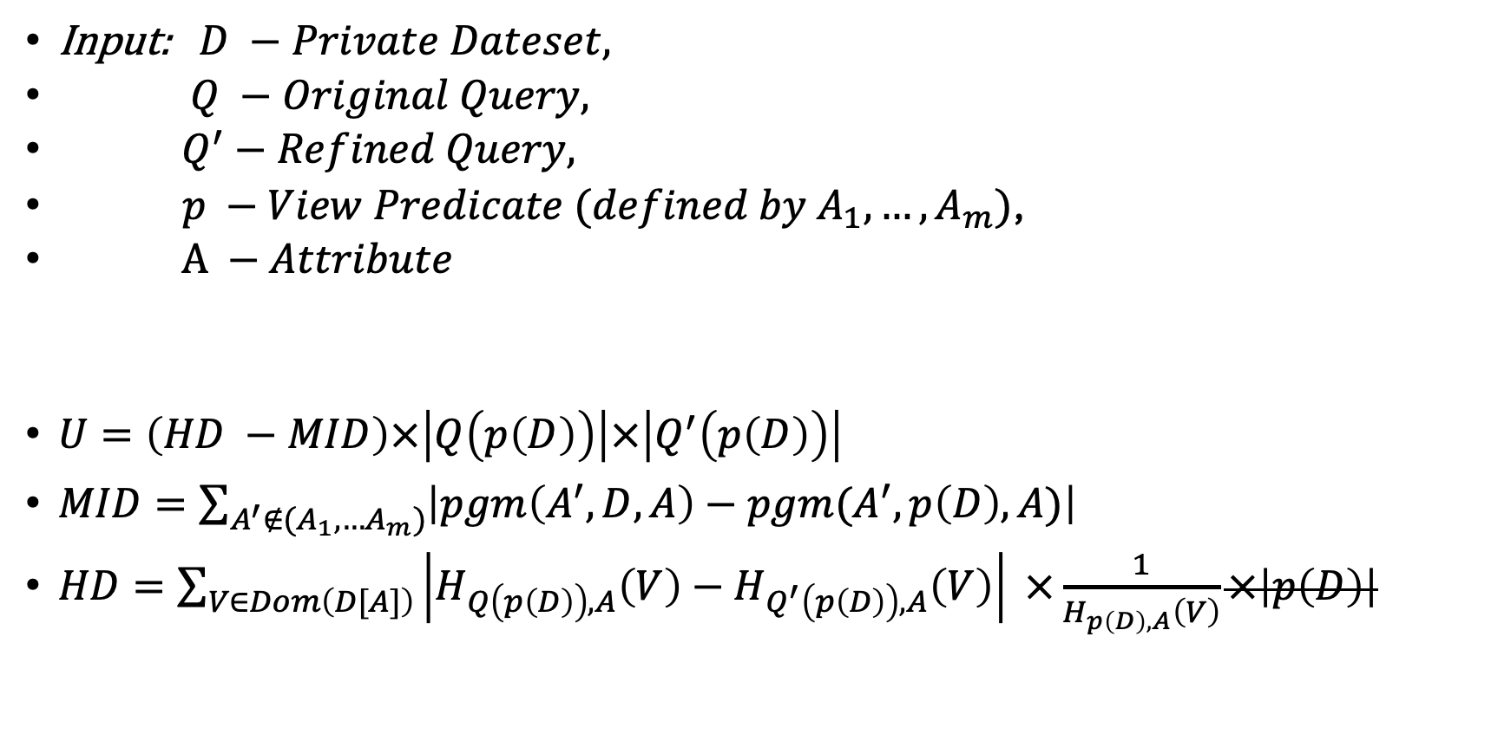
Utility Function – 2nd try
Input: $D −Private Dateset,$
$Q −Original Query,$
$Q^{′}−Refined Query,$
$p −View Predicate (defined by A_{1}, …,A_{m})$,
$A −Attribute$
$U=\left(HD −MID\right)×\left|Q\left(p\left(D\right)\right)\right|×\left|Q^{′}\left(p\left(D\right)\right)\right|$
$MID=\sum_{A^{′}∉(A_{1},…A_{m})}{\left|pgm\left(A^{′},D,A\right)−pgm(A^{′}, p\left(D\right), A)\right|}$
$HD=\sum_{V∈Dom\left(D[A]\right)}{\left|H_{Q\left(p\left(D\right)\right),A}\left(V\right)−H_{Q^{′}\left(p\left(D\right)\right),A}\left(V\right)\right| ×\frac{1}{H_{p\left(D\right),A}\left(V\right)}×\left|p\left(D\right)\right|}$

Slide 14
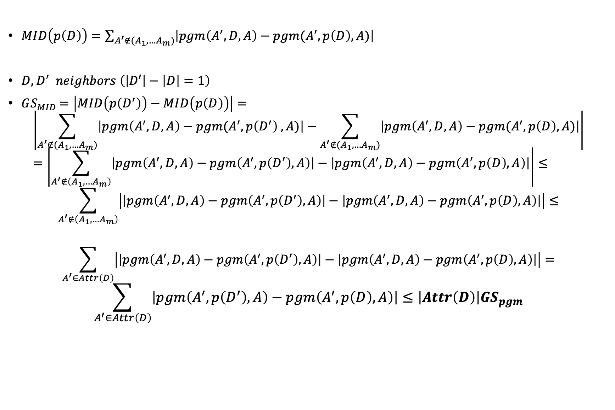
Sensitivity – over D’
$MID\left(p\left(D\right)\right)=\sum_{A^{′}∉(A_{1},…A_{m})}{\left|pgm\left(A^{′},D,A\right)−pgm(A^{′}, p\left(D\right), A)\right|}$
$D,D^{′} neighbors \left(\left|D′\right|−\left|D\right|=1\right)$
$GS_{MID}=\left|MID\left(p\left(D^{′}\right)\right)−MID\left(p\left(D\right)\right)\right|=$
$$\left|\sum_{A^{′}∉(A_{1},…A_{m})}{\left|pgm\left(A^{′},D,A\right)−pgm(A^{′}, p\left(D^{′}\right) ,A)\right|}−\sum_{A^{′}∉(A_{1},…A_{m})}{\left|pgm\left(A^{′},D,A\right)−pgm(A^{′}, p\left(D\right), A)\right|}\right|=\left|\sum_{A^{′}∉\left(A_{1},…A_{m}\right)}{\left|pgm\left(A^{′},D,A\right)−pgm\left(A^{′}, p\left(D^{′}\right), A\right)\right|−\left|pgm\left(A^{′},D,A\right)−pgm\left(A^{′}, p\left(D\right), A\right)\right|}\right|≤$$
$$\sum_{A^{′}∉\left(A_{1},…A_{m}\right)}{\left|\left|pgm\left(A^{′},D,A\right)−pgm\left(A^{′}, p\left(D^{′}\right),A\right)\right|−\left|pgm\left(A^{′},D,A\right)−pgm\left(A^{′}, p\left(D\right), A\right)\right|\right|}≤$$
$$\sum_{A^{′}∈Attr\left(D\right)}{\left|\left|pgm\left(A^{′},D,A\right)−pgm\left(A^{′}, p\left(D^{′}\right),A\right)\right|−\left|pgm\left(A^{′},D,A\right)−pgm\left(A^{′}, p\left(D\right), A\right)\right|\right|}=$$
$$\sum_{A^{′}∈Attr\left(D\right)}{\left|pgm\left(A^{′}, p\left(D^{′}\right), A\right)−pgm\left(A^{′}, p\left(D\right), A\right)\right|≤\left|Attr\left(D\right)\right|GS_{pgm}}$$

Slide 15
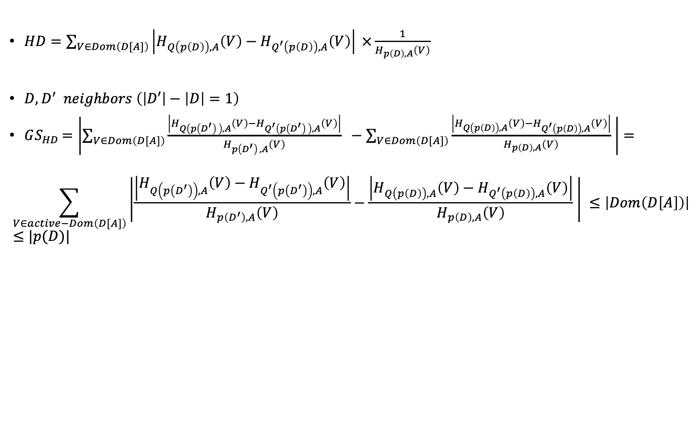
$HD=\sum_{V∈Dom\left(D[A]\right)}{\left|H_{Q\left(p\left(D\right)\right),A}\left(V\right)−H_{Q^{′}\left(p\left(D\right)\right),A}\left(V\right)\right| ×\frac{1}{H_{p\left(D\right),A}\left(V\right)}}$
$D,D^{′} neighbors \left(\left|D′\right|−\left|D\right|=1\right)$
$GS_{HD}=\left|\sum_{V∈Dom\left(D[A]\right)}{\frac{\left|H_{Q\left(p\left(D^{′}\right) \right),A}\left(V\right)−H_{Q^{′}\left(p\left(D^{′}\right) \right),A}\left(V\right)\right|}{H_{p\left(D^{′}\right) ,A}\left(V\right)} } −\sum_{V∈Dom\left(D[A]\right)}{\frac{\left|H_{Q\left(p\left(D\right)\right),A}\left(V\right)−H_{Q^{′}\left(p\left(D\right)\right),A}\left(V\right)\right|}{H_{p\left(D\right),A}\left(V\right)} }\right|=$
$$\sum_{V∈active−Dom\left(D[A]\right)}{\left|\frac{\left|H_{Q\left(p\left(D^{′}\right)\right),A}\left(V\right)−H_{Q^{′}\left(p\left(D^{′}\right)\right),A}\left(V\right)\right|}{H_{p\left(D^{′}\right),A}\left(V\right)}−\frac{\left|H_{Q\left(p\left(D\right)\right),A}\left(V\right)−H_{Q^{′}\left(p\left(D\right)\right),A}\left(V\right)\right|}{H_{p\left(D\right),A}\left(V\right)} \right| }≤\left|Dom\left(D\left[A\right]\right)\right|≤|p(D)|$$

Slide 16
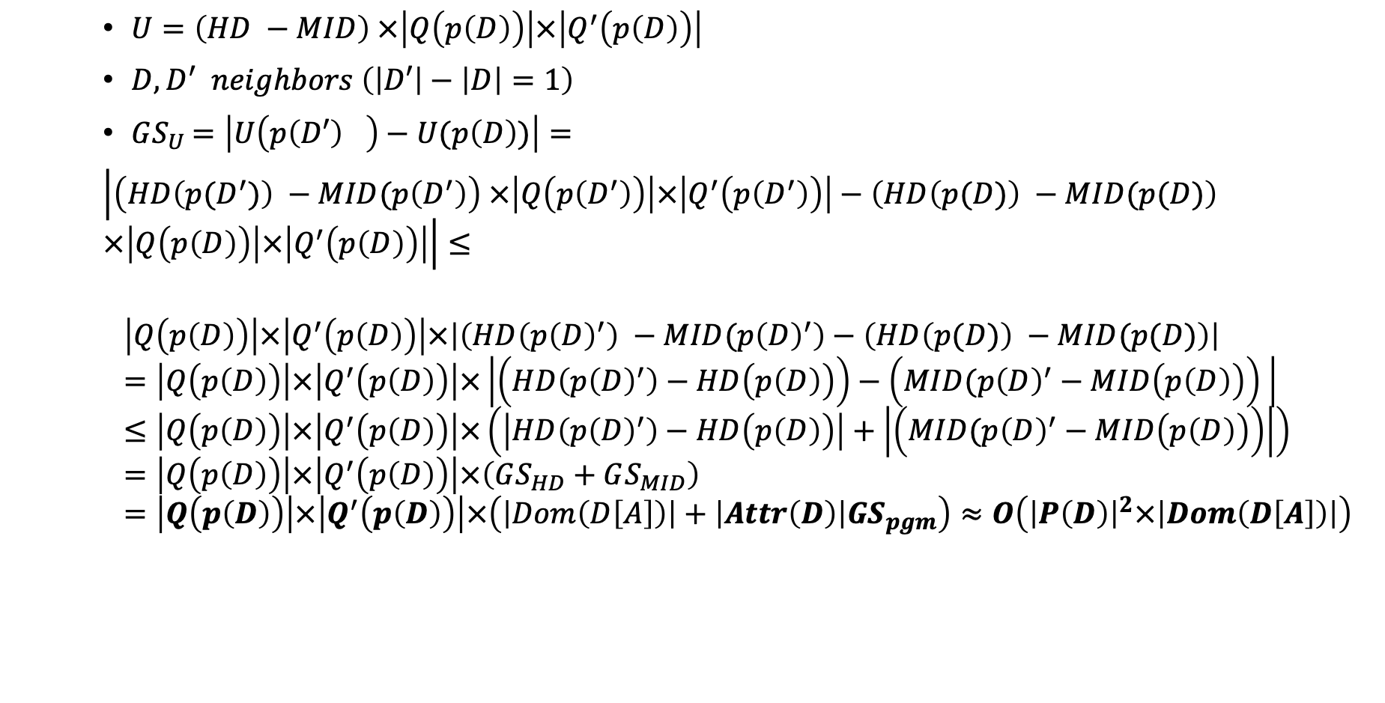
$U=\left(HD −MID\right) ×\left|Q\left(p\left(D\right)\right)\right|×\left|Q^{′}\left(p\left(D\right)\right)\right|$
$D,D^{′} neighbors \left(\left|D′\right|−\left|D\right|=1\right)$
$GS_{U}=\left|U\left(p{\left(D′\right)}^{}\right)−U(p\left(D\right))\right|=$
$\left|\left(HD\left(p(D^{′})\right) −MID(p\left(D^{′}\right)\right) ×\left|Q\left(p\left(D^{′}\right)\right)\right|×\left|Q^{′}\left(p\left(D^{′}\right)\right)\right|−\left(HD\left(p(D)\right) −MID(p(D)\right) ×\left|Q\left(p\left(D\right)\right)\right|×\left|Q^{′}\left(p\left(D\right)\right)\right|\right|≤$
$$\left|Q\left(p\left(D\right)\right)\right|×\left|Q^{′}\left(p\left(D\right)\right)\right|×\left|\left(HD\left(p{\left(D\right)}^{′}\right) −MID(p{\left(D\right)}^{′}\right)−\left(HD\left(p(D)\right) −MID(p(D)\right)\right|=\left|Q\left(p\left(D\right)\right)\right|×\left|Q^{′}\left(p\left(D\right)\right)\right|×\left|\left(HD\left(p{\left(D\right)}^{′}\right)−HD\left(p\left(D\right)\right)\right)−\left(MID(p{\left(D\right)}^{′}−MID\left(p\left(D\right)\right)\right) \right|≤\left|Q\left(p\left(D\right)\right)\right|×\left|Q^{′}\left(p\left(D\right)\right)\right|×\left(\left|HD\left(p{\left(D\right)}^{′}\right)−HD\left(p\left(D\right)\right)\right|+\left|\left(MID(p{\left(D\right)}^{′}−MID\left(p\left(D\right)\right)\right)\right|\right)=\left|Q\left(p\left(D\right)\right)\right|×\left|Q^{′}\left(p\left(D\right)\right)\right|×\left(GS_{HD}+GS_{MID}\right)=\left|Q\left(p\left(D\right)\right)\right|×\left|Q^{′}\left(p\left(D\right)\right)\right|×\left(\left|Dom\left(D\left[A\right]\right)\right|+\left|Attr\left(D\right)\right|GS_{pgm}\right)≈O\left({\left|P\left(D\right)\right|}^{2}×\left|Dom\left(D\left[A\right]\right)\right|\right)$$

Slide 17
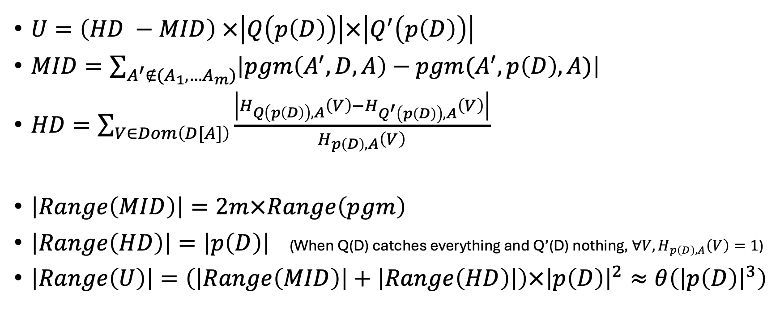
Range – Assume no joins
$U=\left(HD −MID\right) ×\left|Q\left(p\left(D\right)\right)\right|×\left|Q^{′}\left(p\left(D\right)\right)\right|$
$MID=\sum_{A^{′}∉(A_{1},…A_{m})}{\left|pgm\left(A^{′},D,A\right)−pgm(A^{′}, p\left(D\right), A)\right|}$
$HD=\sum_{V∈Dom\left(D[A]\right)}{\frac{\left|H_{Q\left(p\left(D\right)\right),A}\left(V\right)−H_{Q^{′}\left(p\left(D\right)\right),A}\left(V\right)\right|}{H_{p\left(D\right),A}\left(V\right)} }$
$\left|Range\left(MID\right)\right|=2m×Range\left(pgm\right)$
$\left|Range\left(HD\right)\right|=\left|p\left(D\right)\right|$ (When Q(D) catches everything and Q’(D) nothing, $∀V, H_{p\left(D\right),A}\left(V\right)=1$)
$\left|Range\left(U\right)\right|=\left(\left|Range\left(MID\right)\right|+\left|Range\left(HD\right)\right|\right)×{\left|p\left(D\right)\right|}^{2}≈θ\left({\left|p\left(D\right)\right|}^{3}\right)$

Slide 18
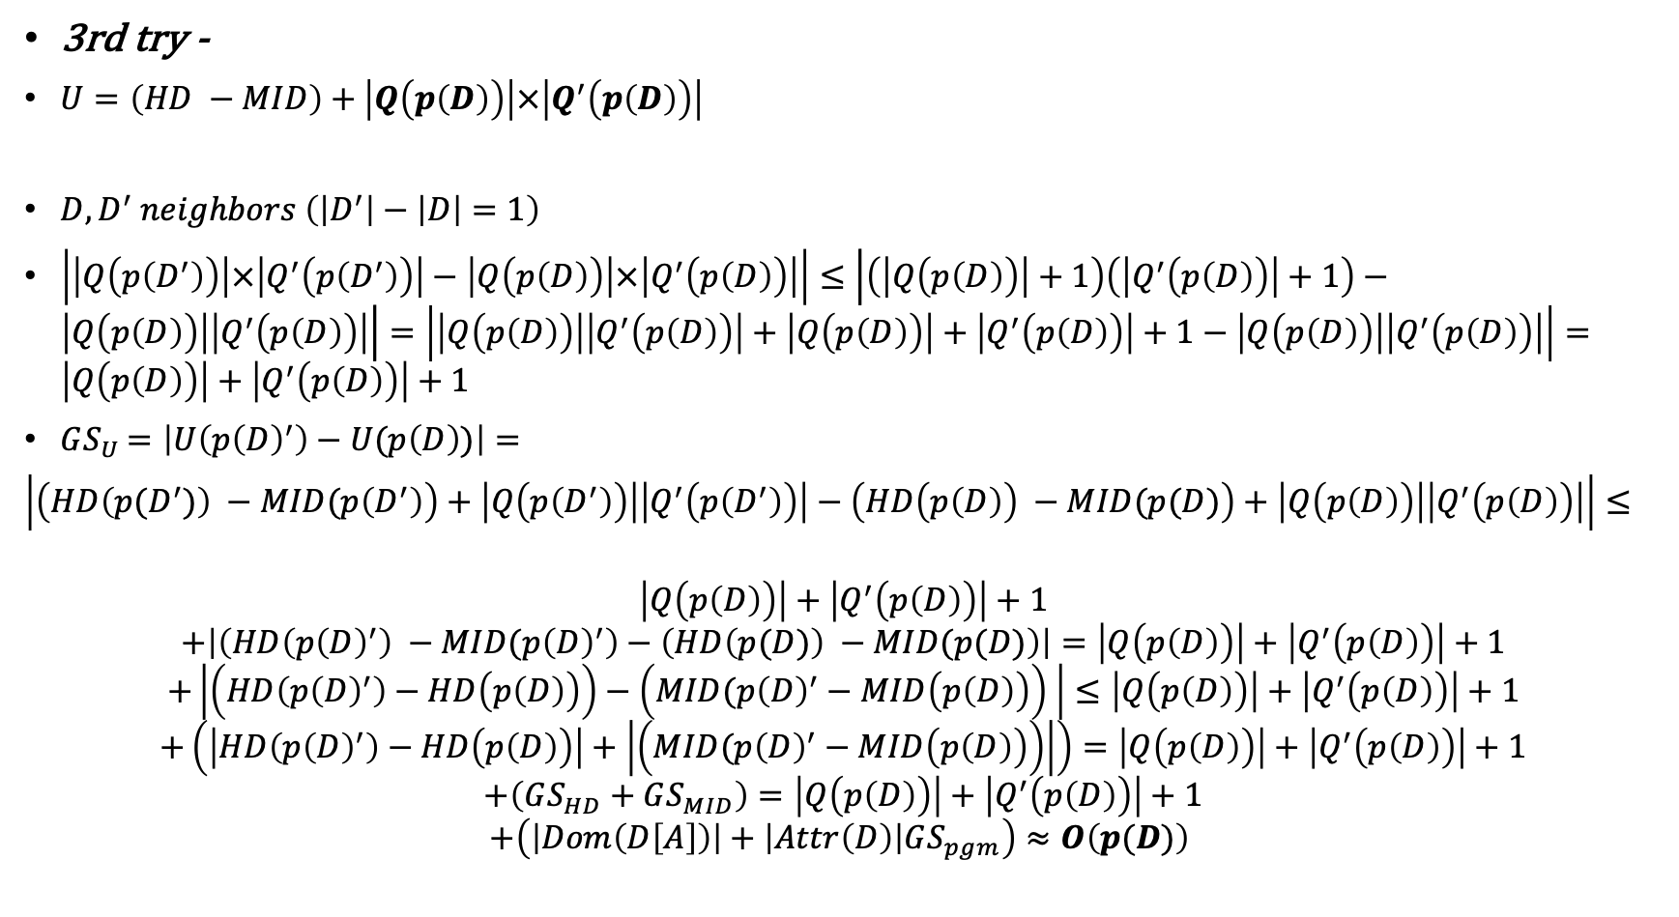
3rd try -
$U=\left(HD −MID\right)+$ $\left|Q\left(p\left(D\right)\right)\right|×\left|Q^{′}\left(p\left(D\right)\right)\right|$
$D,D^{′} neighbors \left(\left|D^{′}\right|−\left|D\right|=1\right)$
$\left|\left|Q\left(p\left(D^{′}\right)\right)\right|×\left|Q^{′}\left(p\left(D^{′}\right)\right)\right|−\left|Q\left(p\left(D\right)\right)\right|×\left|Q^{′}\left(p\left(D\right)\right)\right|\right|≤\left|\left(\left|Q\left(p\left(D\right)\right)\right|+1\right)\left(\left|Q^{′}\left(p\left(D\right)\right)\right|+1\right)−\left|Q\left(p\left(D\right)\right)\right|\left|Q^{′}\left(p\left(D\right)\right)\right|\right|=\left|\left|Q\left(p\left(D\right)\right)\right|\left|Q^{′}\left(p\left(D\right)\right)\right|+\left|Q\left(p\left(D\right)\right)\right|+\left|Q^{′}\left(p\left(D\right)\right)\right|+1−\left|Q\left(p\left(D\right)\right)\right|\left|Q^{′}\left(p\left(D\right)\right)\right|\right|=\left|Q\left(p\left(D\right)\right)\right|+\left|Q^{′}\left(p\left(D\right)\right)\right|+1$
$GS_{U}=\left|U\left(p{\left(D\right)}^{′}\right)−U(p\left(D\right))\right|=$
$\left|\left(HD\left(p(D^{′})\right) −MID(p\left(D^{′}\right)\right)+\left|Q\left(p\left(D^{′}\right)\right)\right|\left|Q^{′}\left(p\left(D^{′}\right)\right)\right|−\left(HD\left(p\left(D\right)\right) −MID(p(D)\right)+\left|Q\left(p\left(D\right)\right)\right|\left|Q^{′}\left(p\left(D\right)\right)\right|\right|≤$
$$\left|Q\left(p\left(D\right)\right)\right|+\left|Q^{′}\left(p\left(D\right)\right)\right|+1$$
$$+\left|\left(HD\left(p{\left(D\right)}^{′}\right) −MID(p{\left(D\right)}^{′}\right)−\left(HD\left(p(D)\right) −MID(p(D)\right)\right|=\left|Q\left(p\left(D\right)\right)\right|+\left|Q^{′}\left(p\left(D\right)\right)\right|+1$$
$$+\left|\left(HD\left(p{\left(D\right)}^{′}\right)−HD\left(p\left(D\right)\right)\right)−\left(MID(p{\left(D\right)}^{′}−MID\left(p\left(D\right)\right)\right) \right|≤\left|Q\left(p\left(D\right)\right)\right|+\left|Q^{′}\left(p\left(D\right)\right)\right|+1$$
$$+\left(\left|HD\left(p{\left(D\right)}^{′}\right)−HD\left(p\left(D\right)\right)\right|+\left|\left(MID(p{\left(D\right)}^{′}−MID\left(p\left(D\right)\right)\right)\right|\right)=\left|Q\left(p\left(D\right)\right)\right|+\left|Q^{′}\left(p\left(D\right)\right)\right|+1$$
$$+\left(GS_{HD}+GS_{MID}\right)=\left|Q\left(p\left(D\right)\right)\right|+\left|Q^{′}\left(p\left(D\right)\right)\right|+1$$
$$+\left(\left|Dom\left(D\left[A\right]\right)\right|+\left|Attr\left(D\right)\right|GS_{pgm}\right)≈O\left(p(D)\right)$$

Slide 19
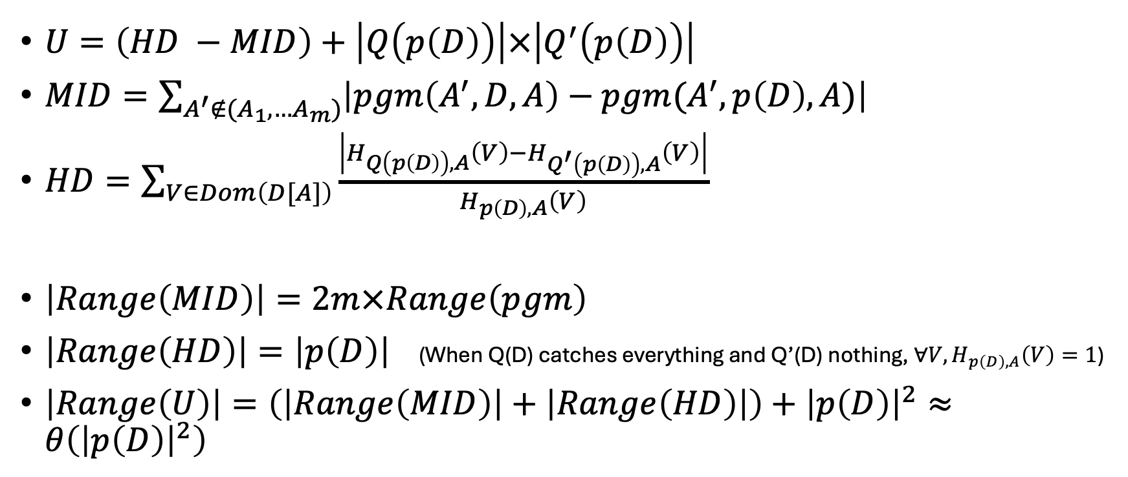
Range – Assume no joins
$U=\left(HD −MID\right)+\left|Q\left(p\left(D\right)\right)\right|×\left|Q^{′}\left(p\left(D\right)\right)\right|$
$MID=\sum_{A^{′}∉(A_{1},…A_{m})}{\left|pgm\left(A^{′},D,A\right)−pgm(A^{′}, p\left(D\right), A)\right|}$
$HD=\sum_{V∈Dom\left(D[A]\right)}{\frac{\left|H_{Q\left(p\left(D\right)\right),A}\left(V\right)−H_{Q^{′}\left(p\left(D\right)\right),A}\left(V\right)\right|}{H_{p\left(D\right),A}\left(V\right)} }$
$\left|Range\left(MID\right)\right|=2m×Range\left(pgm\right)$
$\left|Range\left(HD\right)\right|=\left|p\left(D\right)\right|$ (When Q(D) catches everything and Q’(D) nothing, $∀V, H_{p\left(D\right),A}\left(V\right)=1$)
$\left|Range\left(U\right)\right|=\left(\left|Range\left(MID\right)\right|+\left|Range\left(HD\right)\right|\right)+{\left|p\left(D\right)\right|}^{2}≈θ\left({\left|p\left(D\right)\right|}^{2}\right)$

Slide 20
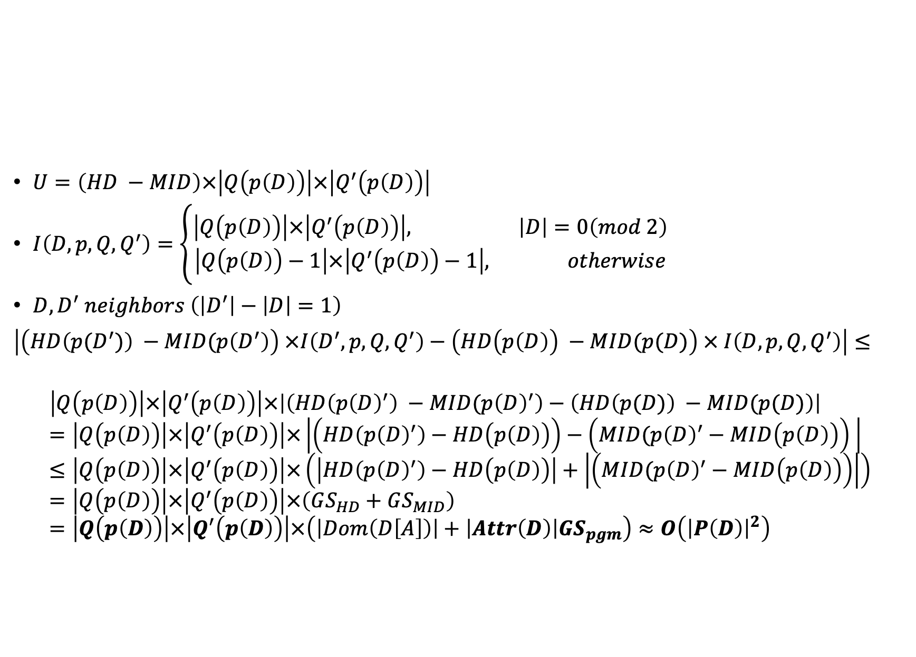
$U=\left(HD −MID\right)×\left|Q\left(p\left(D\right)\right)\right|×\left|Q^{′}\left(p\left(D\right)\right)\right|$
$I\left(D,p,Q,Q^{′}\right)=\left\{\begin{aligned}\left|Q\left(p\left(D\right)\right)\right|×\left|Q^{′}\left(p\left(D\right)\right)\right|, \left|D\right|=0\left(mod 2\right) \\ \left|Q\left(p\left(D\right)\right)−1\right|×\left|Q^{′}\left(p\left(D\right)\right)−1\right|, otherwise\end{aligned}\right.$
$D,D^{′} neighbors \left(\left|D^{′}\right|−\left|D\right|=1\right)$
$\left|\left(HD\left(p(D^{′})\right) −MID(p\left(D^{′}\right)\right) ×I\left(D^{′},p,Q,Q^{′}\right)−\left(HD\left(p\left(D\right)\right) −MID(p(D)\right) × I\left(D,p,Q,Q^{′}\right)\right|≤$
$$\left|Q\left(p\left(D\right)\right)\right|×\left|Q^{′}\left(p\left(D\right)\right)\right|×\left|\left(HD\left(p{\left(D\right)}^{′}\right) −MID(p{\left(D\right)}^{′}\right)−\left(HD\left(p(D)\right) −MID(p(D)\right)\right|=\left|Q\left(p\left(D\right)\right)\right|×\left|Q^{′}\left(p\left(D\right)\right)\right|×\left|\left(HD\left(p{\left(D\right)}^{′}\right)−HD\left(p\left(D\right)\right)\right)−\left(MID(p{\left(D\right)}^{′}−MID\left(p\left(D\right)\right)\right) \right|≤\left|Q\left(p\left(D\right)\right)\right|×\left|Q^{′}\left(p\left(D\right)\right)\right|×\left(\left|HD\left(p{\left(D\right)}^{′}\right)−HD\left(p\left(D\right)\right)\right|+\left|\left(MID(p{\left(D\right)}^{′}−MID\left(p\left(D\right)\right)\right)\right|\right)=\left|Q\left(p\left(D\right)\right)\right|×\left|Q^{′}\left(p\left(D\right)\right)\right|×\left(GS_{HD}+GS_{MID}\right)=\left|Q\left(p\left(D\right)\right)\right|×\left|Q^{′}\left(p\left(D\right)\right)\right|×\left(\left|Dom\left(D\left[A\right]\right)\right|+\left|Attr\left(D\right)\right|GS_{pgm}\right)≈O\left({\left|P\left(D\right)\right|}^{2}\right)$$

Slide 21
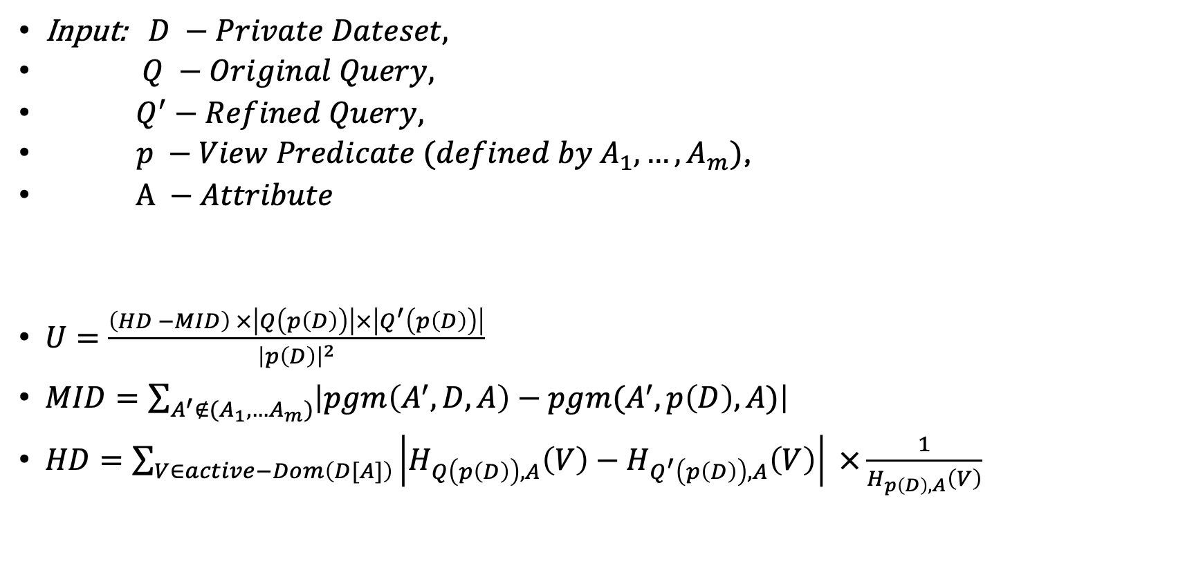
10.05 - Utility Function – 4th try
Input: $D −Private Dateset,$
$Q −Original Query,$
$Q^{′}−Refined Query,$
$p −View Predicate (defined by A_{1}, …,A_{m})$,
$A −Attribute$
$U=\frac{\left(HD −MID\right) ×\left|Q\left(p\left(D\right)\right)\right|×\left|Q^{′}\left(p\left(D\right)\right)\right|}{{\left|p\left(D\right)\right|}^{2}}$
$MID=\sum_{A^{′}∉(A_{1},…A_{m})}{\left|pgm\left(A^{′},D,A\right)−pgm(A^{′}, p\left(D\right), A)\right|}$
$HD=\sum_{V∈active−Dom\left(D[A]\right)}{\left|H_{Q\left(p\left(D\right)\right),A}\left(V\right)−H_{Q^{′}\left(p\left(D\right)\right),A}\left(V\right)\right| ×\frac{1}{H_{p\left(D\right),A}\left(V\right)}}$

Slide 22
Sensitivity – over D’
$MID\left(p\left(D\right)\right)=\sum_{A^{′}∉(A_{1},…A_{m})}{\left|pgm\left(A^{′},D,A\right)−pgm(A^{′}, p\left(D\right), A)\right|}$
$D,D^{′} neighbors \left(\left|D′\right|−\left|D\right|=1\right)$
$GS_{MID}=\left|MID\left(p\left(D^{′}\right)\right)−MID\left(p\left(D\right)\right)\right|=$
$$\left|\sum_{A^{′}∉(A_{1},…A_{m})}{\left|pgm\left(A^{′},D,A\right)−pgm(A^{′}, p\left(D^{′}\right) ,A)\right|}−\sum_{A^{′}∉(A_{1},…A_{m})}{\left|pgm\left(A^{′},D,A\right)−pgm(A^{′}, p\left(D\right), A)\right|}\right|=\left|\sum_{A^{′}∉\left(A_{1},…A_{m}\right)}{\left|pgm\left(A^{′},D,A\right)−pgm\left(A^{′}, p\left(D^{′}\right), A\right)\right|−\left|pgm\left(A^{′},D,A\right)−pgm\left(A^{′}, p\left(D\right), A\right)\right|}\right|≤$$
$$\sum_{A^{′}∉\left(A_{1},…A_{m}\right)}{\left|\left|pgm\left(A^{′},D,A\right)−pgm\left(A^{′}, p\left(D^{′}\right),A\right)\right|−\left|pgm\left(A^{′},D,A\right)−pgm\left(A^{′}, p\left(D\right), A\right)\right|\right|}≤$$
$$\sum_{A^{′}∈Attr\left(D\right)}{\left|\left|pgm\left(A^{′},D,A\right)−pgm\left(A^{′}, p\left(D^{′}\right),A\right)\right|−\left|pgm\left(A^{′},D,A\right)−pgm\left(A^{′}, p\left(D\right), A\right)\right|\right|}=$$
$$\sum_{A^{′}∈Attr\left(D\right)}{\left|pgm\left(A^{′}, p\left(D^{′}\right), A\right)−pgm\left(A^{′}, p\left(D\right), A\right)\right|≤\left|Attr\left(D\right)\right|GS_{pgm}}$$

Slide 23
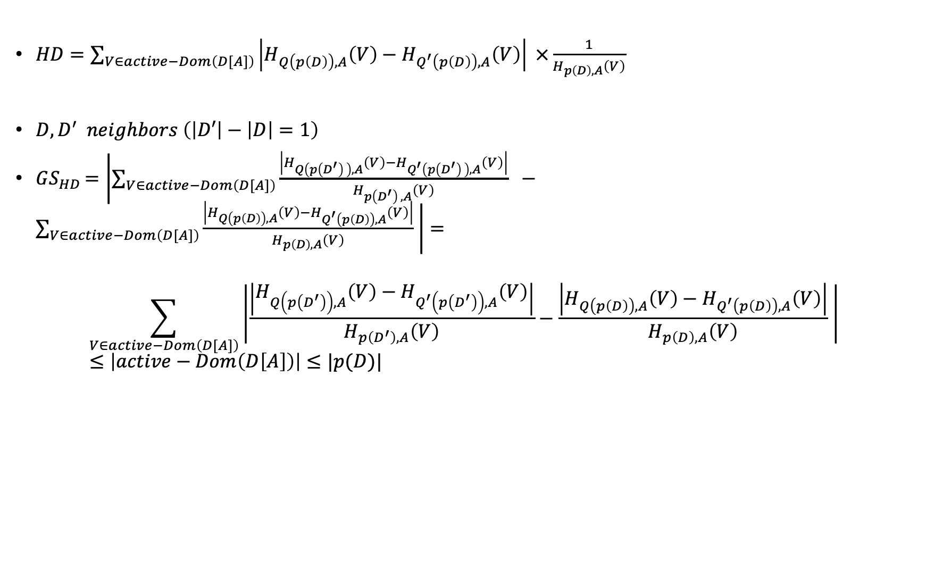
$HD=\sum_{V∈active−Dom\left(D[A]\right)}{\left|H_{Q\left(p\left(D\right)\right),A}\left(V\right)−H_{Q^{′}\left(p\left(D\right)\right),A}\left(V\right)\right| ×\frac{1}{H_{p\left(D\right),A}\left(V\right)}}$
$D,D^{′} neighbors \left(\left|D′\right|−\left|D\right|=1\right)$
$GS_{HD}=\left|\sum_{V∈active−Dom\left(D[A]\right)}{\frac{\left|H_{Q\left(p\left(D^{′}\right) \right),A}\left(V\right)−H_{Q^{′}\left(p\left(D^{′}\right) \right),A}\left(V\right)\right|}{H_{p\left(D^{′}\right) ,A}\left(V\right)} } −\sum_{V∈active−Dom\left(D[A]\right)}{\frac{\left|H_{Q\left(p\left(D\right)\right),A}\left(V\right)−H_{Q^{′}\left(p\left(D\right)\right),A}\left(V\right)\right|}{H_{p\left(D\right),A}\left(V\right)} }\right|=$
$$\sum_{V∈active−Dom\left(D[A]\right)}{\left|\frac{\left|H_{Q\left(p\left(D^{′}\right)\right),A}\left(V\right)−H_{Q^{′}\left(p\left(D^{′}\right)\right),A}\left(V\right)\right|}{H_{p\left(D^{′}\right),A}\left(V\right)}−\frac{\left|H_{Q\left(p\left(D\right)\right),A}\left(V\right)−H_{Q^{′}\left(p\left(D\right)\right),A}\left(V\right)\right|}{H_{p\left(D\right),A}\left(V\right)} \right| }≤\left|active−Dom\left(D\left[A\right]\right)\right|≤|p(D)|$$

Slide 24
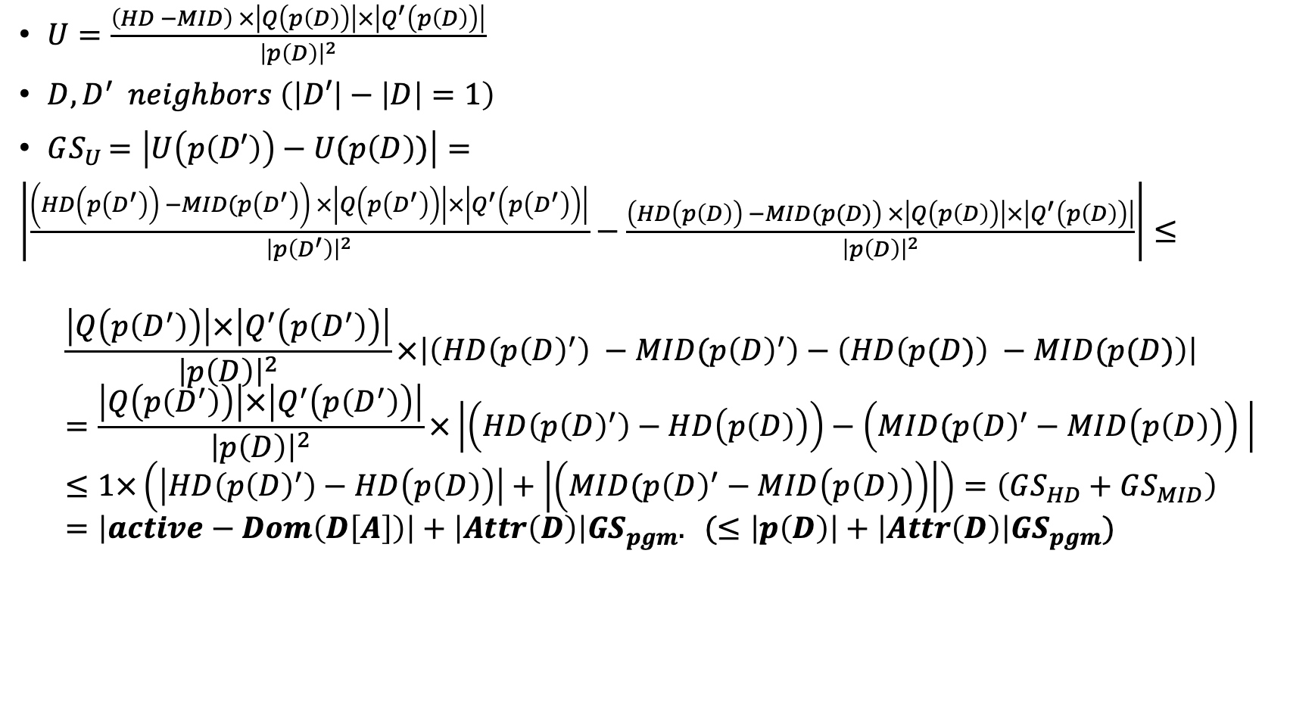
$U=\frac{\left(HD −MID\right) ×\left|Q\left(p\left(D\right)\right)\right|×\left|Q^{′}\left(p\left(D\right)\right)\right|}{{\left|p\left(D\right)\right|}^{2}}$
$D,D^{′} neighbors \left(\left|D′\right|−\left|D\right|=1\right)$
$GS_{U}=\left|U\left(p\left(D′\right)\right)−U(p\left(D\right))\right|=$
$\left|\frac{\left(HD\left(p\left(D^{′}\right)\right) −MID(p\left(D^{′}\right)\right) ×\left|Q\left(p\left(D^{′}\right)\right)\right|×\left|Q^{′}\left(p\left(D^{′}\right)\right)\right|}{{\left|p\left(D^{′}\right)\right|}^{2}}−\frac{\left(HD\left(p\left(D\right)\right) −MID(p(D)\right) ×\left|Q\left(p\left(D\right)\right)\right|×\left|Q^{′}\left(p\left(D\right)\right)\right|}{{\left|p\left(D\right)\right|}^{2}}\right|≤$
$$\frac{\left|Q\left(p\left(D^{′}\right)\right)\right|×\left|Q^{′}\left(p\left(D^{′}\right)\right)\right|}{{\left|p\left(D\right)\right|}^{2}}×\left|\left(HD\left(p{\left(D\right)}^{′}\right) −MID(p{\left(D\right)}^{′}\right)−\left(HD\left(p(D)\right) −MID(p(D)\right)\right|=\frac{\left|Q\left(p\left(D^{′}\right)\right)\right|×\left|Q^{′}\left(p\left(D^{′}\right)\right)\right|}{{\left|p\left(D\right)\right|}^{2}}×\left|\left(HD\left(p{\left(D\right)}^{′}\right)−HD\left(p\left(D\right)\right)\right)−\left(MID(p{\left(D\right)}^{′}−MID\left(p\left(D\right)\right)\right) \right|≤1×\left(\left|HD\left(p{\left(D\right)}^{′}\right)−HD\left(p\left(D\right)\right)\right|+\left|\left(MID(p{\left(D\right)}^{′}−MID\left(p\left(D\right)\right)\right)\right|\right)=\left(GS_{HD}+GS_{MID}\right)=\left|active−Dom\left(D\left[A\right]\right)\right|+\left|Attr\left(D\right)\right|GS_{pgm}. (≤\left|p\left(D\right)\right|+\left|Attr\left(D\right)\right|GS_{pgm})$$
Active-domain == number of buckets

Slide 25
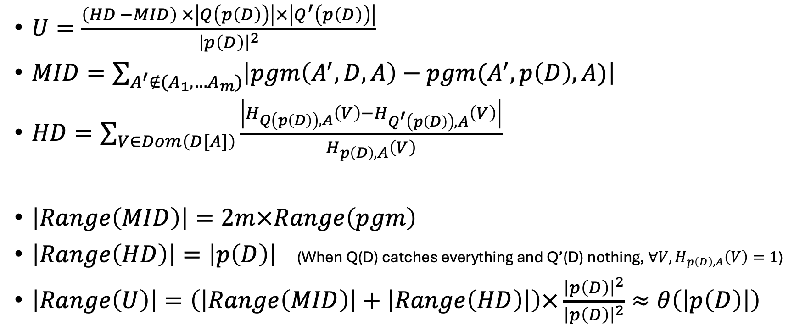
Range – Assume no joins
$U=\frac{\left(HD −MID\right) ×\left|Q\left(p\left(D\right)\right)\right|×\left|Q^{′}\left(p\left(D\right)\right)\right|}{{\left|p\left(D\right)\right|}^{2}}$
$MID=\sum_{A^{′}∉(A_{1},…A_{m})}{\left|pgm\left(A^{′},D,A\right)−pgm(A^{′}, p\left(D\right), A)\right|}$
$HD=\sum_{V∈Dom\left(D[A]\right)}{\frac{\left|H_{Q\left(p\left(D\right)\right),A}\left(V\right)−H_{Q^{′}\left(p\left(D\right)\right),A}\left(V\right)\right|}{H_{p\left(D\right),A}\left(V\right)} }$
$\left|Range\left(MID\right)\right|=2m×Range\left(pgm\right)$
$\left|Range\left(HD\right)\right|=\left|p\left(D\right)\right|$ (When Q(D) catches everything and Q’(D) nothing, $∀V, H_{p\left(D\right),A}\left(V\right)=1$)
$\left|Range\left(U\right)\right|=\left(\left|Range\left(MID\right)\right|+\left|Range\left(HD\right)\right|\right)×\frac{{\left|p\left(D\right)\right|}^{2}}{{\left|p\left(D\right)\right|}^{2}}≈θ\left(\left|p\left(D\right)\right|\right)$

Slide 26
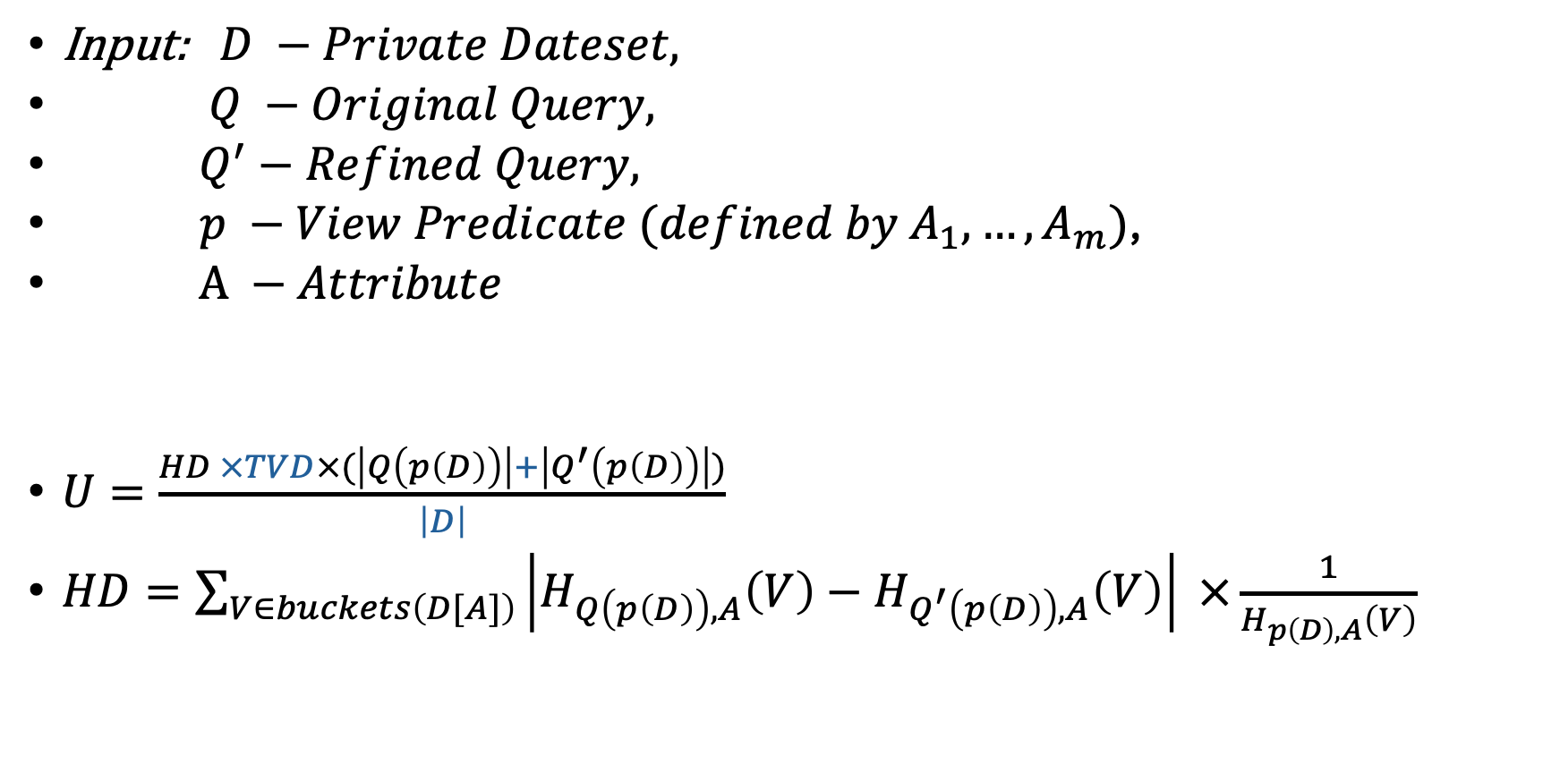
20.05 - Utility Function – 5th try
prev time: $U=\frac{\left(HD −MID\right) ×\left|Q\left(p\left(D\right)\right)\right|×\left|Q^{′}\left(p\left(D\right)\right)\right|}{{\left|p\left(D\right)\right|}^{2}}$
Input: $D −Private Dateset,$
$Q −Original Query,$
$Q^{′}−Refined Query,$
$p −View Predicate (defined by A_{1}, …,A_{m})$,
$A −Attribute$
$U=\frac{HD ×TVD×(\left|Q\left(p\left(D\right)\right)\right|+\left|Q^{′}\left(p\left(D\right)\right)\right|)}{\left|D\right|}$
$HD=\sum_{V∈buckets\left(D[A]\right)}{\left|H_{Q\left(p\left(D\right)\right),A}\left(V\right)−H_{Q^{′}\left(p\left(D\right)\right),A}\left(V\right)\right| ×\frac{1}{H_{p\left(D\right),A}\left(V\right)}}$

Slide 27
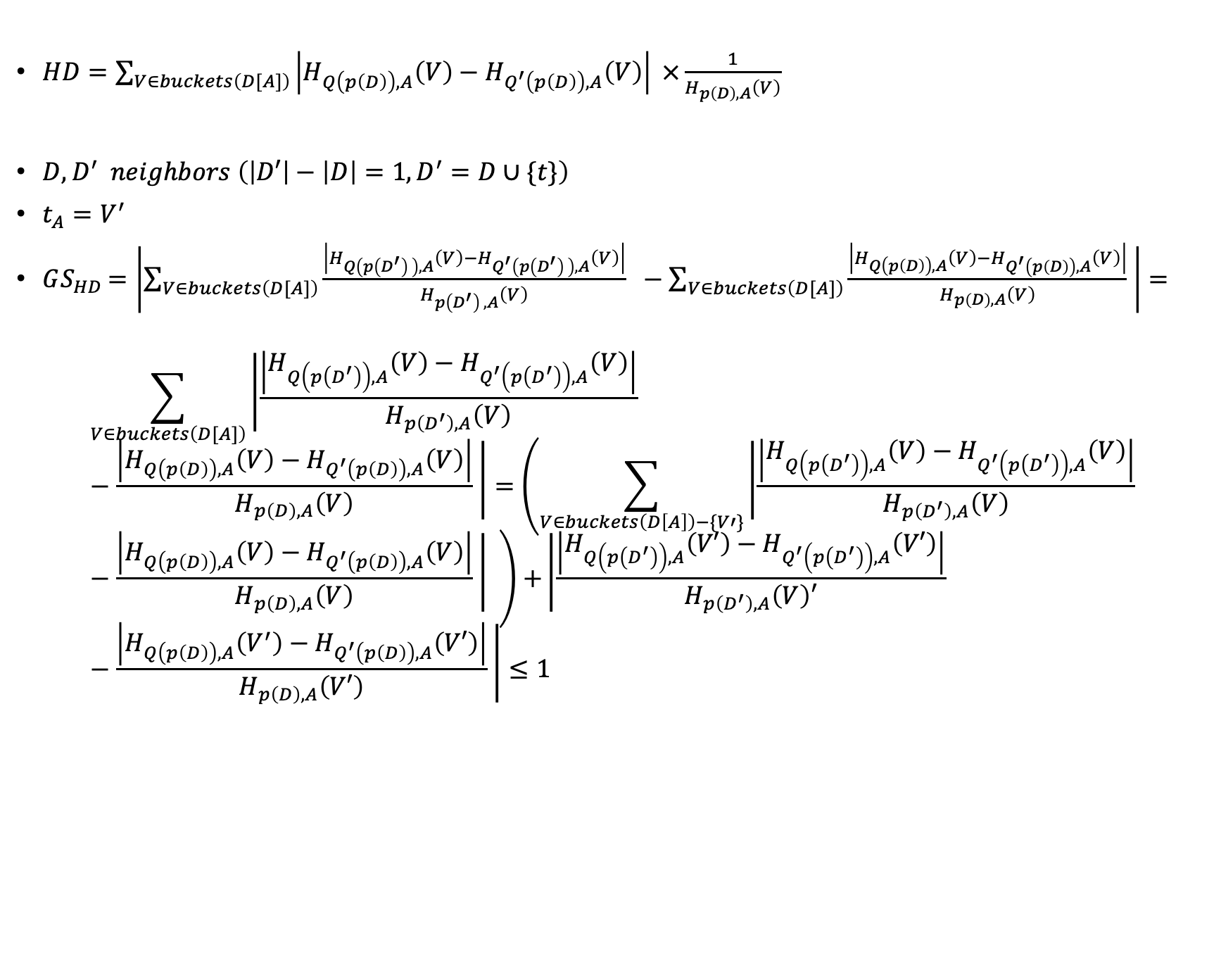
$HD=\sum_{V∈buckets\left(D[A]\right)}{\left|H_{Q\left(p\left(D\right)\right),A}\left(V\right)−H_{Q^{′}\left(p\left(D\right)\right),A}\left(V\right)\right| ×\frac{1}{H_{p\left(D\right),A}\left(V\right)}}$
$D,D^{′} neighbors \left(\left|D′\right|−\left|D\right|=1, D^{′}=D∪\{t\}\right)$
$t_{A}=V^{′}$
$GS_{HD}=\left|\sum_{V∈buckets\left(D[A]\right)}{\frac{\left|H_{Q\left(p\left(D^{′}\right) \right),A}\left(V\right)−H_{Q^{′}\left(p\left(D^{′}\right) \right),A}\left(V\right)\right|}{H_{p\left(D^{′}\right) ,A}\left(V\right)} } −\sum_{V∈buckets\left(D[A]\right)}{\frac{\left|H_{Q\left(p\left(D\right)\right),A}\left(V\right)−H_{Q^{′}\left(p\left(D\right)\right),A}\left(V\right)\right|}{H_{p\left(D\right),A}\left(V\right)} }\right|=$
$$\sum_{V∈buckets\left(D[A]\right)}{\left|\frac{\left|H_{Q\left(p\left(D^{′}\right)\right),A}\left(V\right)−H_{Q^{′}\left(p\left(D^{′}\right)\right),A}\left(V\right)\right|}{H_{p\left(D^{′}\right),A}\left(V\right)}−\frac{\left|H_{Q\left(p\left(D\right)\right),A}\left(V\right)−H_{Q^{′}\left(p\left(D\right)\right),A}\left(V\right)\right|}{H_{p\left(D\right),A}\left(V\right)} \right|=\left(\sum_{V∈buckets\left(D\left[A\right]\right)−\{V′\}}{\left|\frac{\left|H_{Q\left(p\left(D^{′}\right)\right),A}\left(V\right)−H_{Q^{′}\left(p\left(D^{′}\right)\right),A}\left(V\right)\right|}{H_{p\left(D^{′}\right),A}\left(V\right)}−\frac{\left|H_{Q\left(p\left(D\right)\right),A}\left(V\right)−H_{Q^{′}\left(p\left(D\right)\right),A}\left(V\right)\right|}{H_{p\left(D\right),A}\left(V\right)} \right| }\right)+}\left|\frac{\left|H_{Q\left(p\left(D^{′}\right)\right),A}\left(V′\right)−H_{Q^{′}\left(p\left(D^{′}\right)\right),A}\left(V′\right)\right|}{H_{p\left(D^{′}\right),A}\left(V\right)′}−\frac{\left|H_{Q\left(p\left(D\right)\right),A}\left(V^{′}\right)−H_{Q^{′}\left(p\left(D\right)\right),A}\left(V′\right)\right|}{H_{p\left(D\right),A}\left(V′\right)} \right|≤1$$

Slide 28
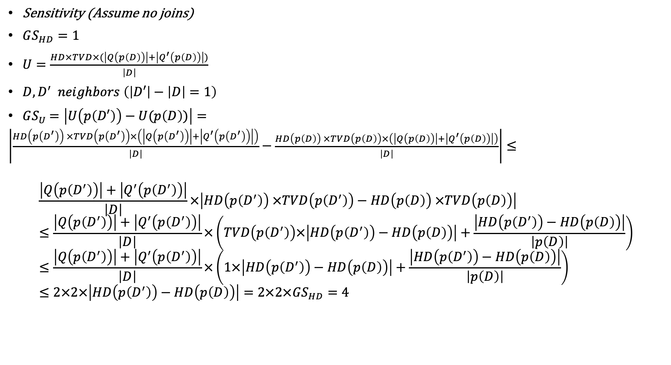
Sensitivity (Assume no joins)
$GS_{HD}=1$
$U=\frac{HD×TVD×(\left|Q\left(p\left(D\right)\right)\right|+\left|Q^{′}\left(p\left(D\right)\right)\right|)}{\left|D\right|}$
$D,D^{′} neighbors \left(\left|D′\right|−\left|D\right|=1\right)$
$GS_{U}=\left|U\left(p\left(D′\right)\right)−U(p\left(D\right))\right|=$
$\left|\frac{HD\left(p\left(D^{′}\right)\right) ×TVD\left(p\left(D^{′}\right)\right)×\left(\left|Q\left(p\left(D^{′}\right)\right)\right|+\left|Q^{′}\left(p\left(D^{′}\right)\right)\right|\right)}{\left|D\right|}−\frac{HD\left(p\left(D\right)\right) ×TVD\left(p\left(D\right)\right)×\left(\left|Q\left(p\left(D\right)\right)\right|+\left|Q^{′}\left(p\left(D\right)\right)\right|\right)}{\left|D\right|}\right|≤$
$$\frac{\left|Q\left(p\left(D^{′}\right)\right)\right|+\left|Q^{′}\left(p\left(D^{′}\right)\right)\right|}{\left|D\right|}×\left|HD\left(p\left(D^{′}\right)\right) ×TVD\left(p\left(D^{′}\right)\right)−HD\left(p\left(D\right)\right) ×TVD\left(p\left(D\right)\right)\right|≤\frac{\left|Q\left(p\left(D^{′}\right)\right)\right|+\left|Q^{′}\left(p\left(D^{′}\right)\right)\right|}{\left|D\right|}×\left(TVD\left(p\left(D^{′}\right)\right)×\left|HD\left(p\left(D^{′}\right)\right)−HD\left(p\left(D\right)\right)\right|+\frac{\left|HD\left(p\left(D^{′}\right)\right)−HD\left(p\left(D\right)\right)\right|}{\left|p\left(D\right)\right|}\right)≤\frac{\left|Q\left(p\left(D^{′}\right)\right)\right|+\left|Q^{′}\left(p\left(D^{′}\right)\right)\right|}{\left|D\right|}×\left(1×\left|HD\left(p\left(D^{′}\right)\right)−HD\left(p\left(D\right)\right)\right|+\frac{\left|HD\left(p\left(D^{′}\right)\right)−HD\left(p\left(D\right)\right)\right|}{\left|p\left(D\right)\right|}\right)≤2×2×\left|HD\left(p\left(D^{′}\right)\right)−HD\left(p\left(D\right)\right)\right|=2×2×GS_{HD}=4$$

Slide 29
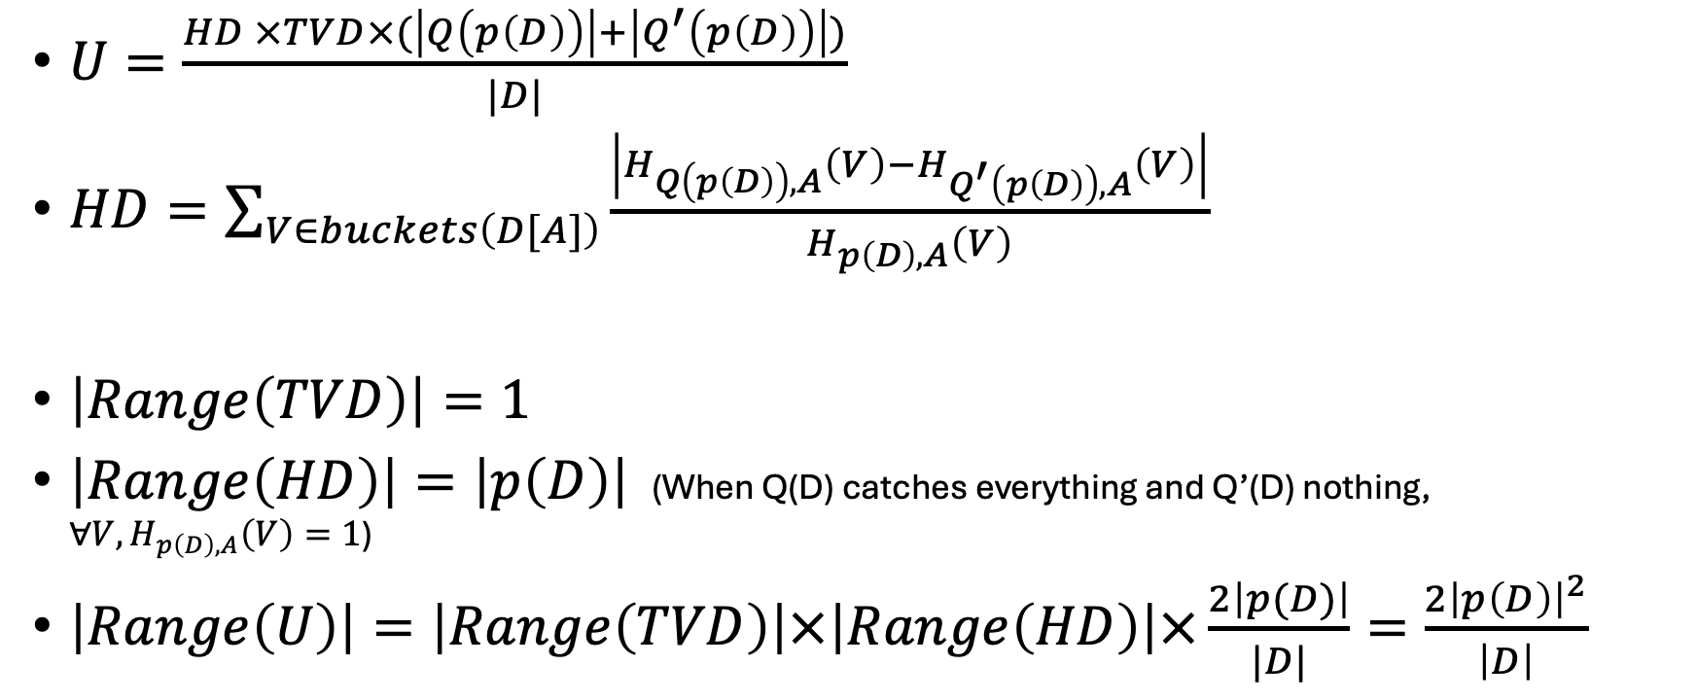
Range – Assume no joins
$U=\frac{HD ×TVD×(\left|Q\left(p\left(D\right)\right)\right|+\left|Q^{′}\left(p\left(D\right)\right)\right|)}{|D|}$
$HD=\sum_{V∈buckets\left(D[A]\right)}{\frac{\left|H_{Q\left(p\left(D\right)\right),A}\left(V\right)−H_{Q^{′}\left(p\left(D\right)\right),A}\left(V\right)\right|}{H_{p\left(D\right),A}\left(V\right)} }$
$\left|Range\left(TVD\right)\right|=1$
$\left|Range\left(HD\right)\right|=\left|p\left(D\right)\right|$ (When Q(D) catches everything and Q’(D) nothing, $∀V, H_{p\left(D\right),A}\left(V\right)=1$)
$\left|Range\left(U\right)\right|=\left|Range\left(TVD\right)\right|×\left|Range\left(HD\right)\right|×\frac{2\left|p(D)\right|}{|D|}=\frac{{2\left|p\left(D\right)\right|}^{2}}{\left|D\right|}$

Slide 30
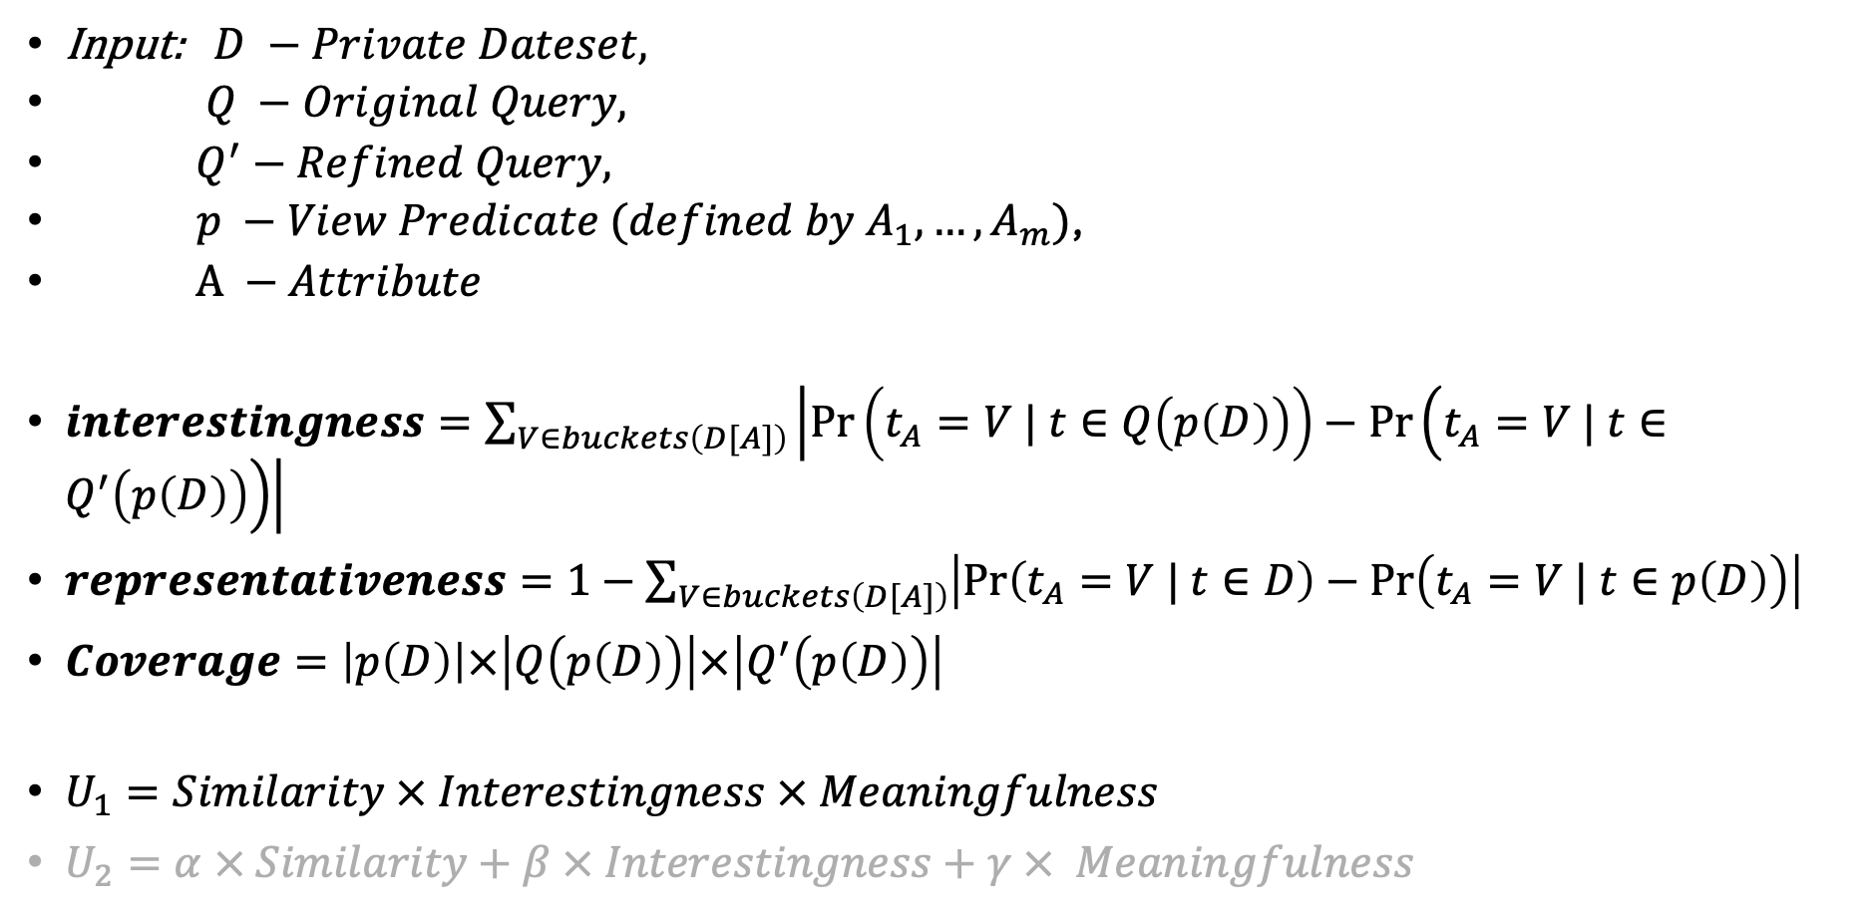
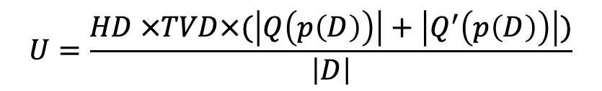
$$U=\frac{HD ×TVD×(\left|Q\left(p\left(D\right)\right)\right|+\left|Q^{′}\left(p\left(D\right)\right)\right|)}{\left|D\right|}$$
Input: $D −Private Dateset,$
$Q −Original Query,$
$Q^{′}−Refined Query,$
$p −View Predicate (defined by A_{1}, …,A_{m})$,
$A −Attribute$
$interestingness=\sum_{V∈buckets\left(D[A]\right)}{\left|\operatorname{Pr}\left(t_{A}=V | t∈Q\left(p\left(D\right)\right)\right)−\operatorname{Pr}\left(t_{A}=V | t∈Q^{′}\left(p\left(D\right)\right)\right)\right|}$
$representativeness=1−\sum_{V∈buckets\left(D[A]\right)}{\left|\operatorname{Pr}\left(t_{A}=V | t∈D\right)−\operatorname{Pr}\left(t_{A}=V | t∈p\left(D\right)\right)\right|}$
$Coverage=\left|p\left(D\right)\right|×\left|Q\left(p\left(D\right)\right)\right|×\left|Q^{′}\left(p\left(D\right)\right)\right|$
$U_{1}=Similarity × Interestingness × Meaningfulness$
$U_{2}=α × Similarity+β × Interestingness+γ × Meaningfulness$

Slide 31
Experiments Design
base
base
base
base
Experiment:
(->BaseExperiment)
Date + Time
Description
Dataset
Query
Constraints
Refinement Algorithm=None
K
Epsilon
Methods:
Experiemnt(conf/args)
Run(output_plot, output_debug)
base
Dataset:
Name
Path
Attribute[]
Medotds:
Query(Conf/args)
build
DemographicGroup:
Attribute
Value
Condition:
Attribute
Operator
Values: list
Query:
Dataset
Conditions
Label
Medotds:
Query(Conf/args)
Where(Cond)
Build
Run -> DF
Conditions:
Condition[]
base
Constraint:
Demo…Group
Operator: Enum
Value: int
BaseObject:
Methods:
Validate
Save_conf
Load_conf
base
AttrType: Enum
Attribute:
Name : str
AttrType : Enum
isSensitive: Bool
Range : iterator
Constraints:
Constraint[]
Operator: Enum

Slide 32
Experiments Design
Validate
Save_conf
Load_conf
validate
validate
validate
Exponential
Mechanism:
Date + Time
Dataset
Query
Constraints
Refinement Algorithm=None
K
Epsilon
Methods:
Experiemnt(conf/args)
Run(output_plot, output_debug)
Save_conf
Condition:
Attribute
Operator
Values: list
Query:
Dataset
Conditions
Label
Medotds:
Query(Conf/args)
Where(Cond)
Build
Run -> DF
Dataset:
Name
Path
Attribute[]
Medotds:
Query(Conf/args)
build
DemographicGroup:
Attribute
Value
Conditions:
Condition[]
Constraint:
Demo…Group
Operator: Enum
Value: int
Attribute:
Name : str
AttrType : Enum
isSensitive: Bool
Range : iterator
AttrType: Enum
Constraints:
Constraint[]
Operator: Enum

Slide 33

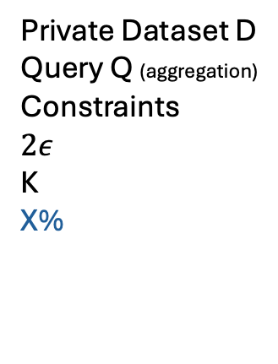
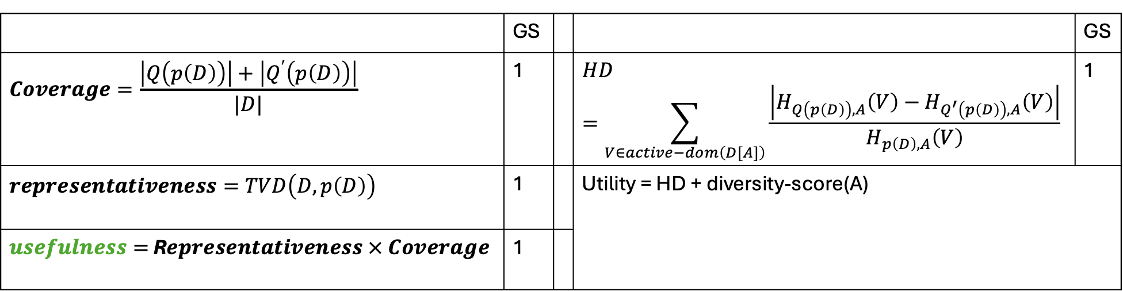
Exponential Mechanism:
Choose the top-X% views using the usefulness filter
$$∀A∈Attrs$$
Exponential Mechanism:
Choose the best view using HD
Find the top-K scored attributes and generate noisy histograms
Private Dataset D
Query Q (aggregation)
Constraints
$$2ε$$
K
X%
Views generation using predicates
Refinement Algorithm
Q’
…
Constraint attr
Generate noisy histogram
 | GS |  |  | GS
$$Coverage=\frac{\left|Q\left(p\left(D\right)\right)\right|+\left|Q^{′}\left(p\left(D\right)\right)\right|}{|D|}$$ | 1 |  | $$HD=\sum_{V∈active−dom\left(D[A]\right)}{\frac{\left|H_{Q\left(p\left(D\right)\right),A}\left(V\right)−H_{Q^{′}\left(p\left(D\right)\right),A}\left(V\right)\right|}{H_{p\left(D\right),A}\left(V\right)} }$$ | 1
$$representativeness=TVD\left(D,p\left(D\right)\right)$$ | 1 |  | Utility = HD + diversity-score(A)
$usefulness=$ R$epresentativeness × Coverage$ | 1

Slide 34

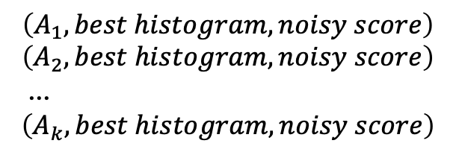
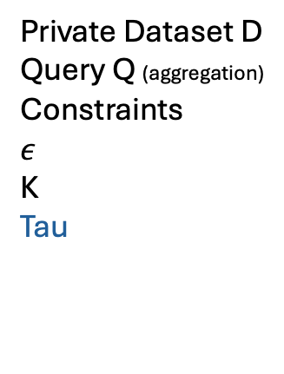

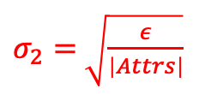
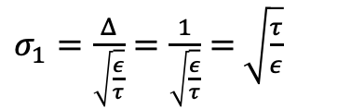
Privacy Analayzing using Composition Rules
$σ_{1}=\frac{Δ}{\sqrt{\frac{ε}{τ}}}=\frac{1}{\sqrt{\frac{ε}{τ}}}=$ $\sqrt{\frac{τ}{ε}}$
$$\left(A_{1}, best histogram, noisy score\right)$$
$$\left(A_{2}, best histogram, noisy score\right)$$
…
$$\left(A_{k}, best histogram, noisy score\right)$$
*
Exponential Mechanism:
Choose the top-tau views using the usefulness filter
$$∀A∈Attrs$$
Exponential Mechanism:
Choose the best view using HD
Find the top-K scored attributes and generate noisy histograms
Private Dataset D
Query Q (aggregation)
Constraints
$$ε$$
K
Tau
Views generation using predicates
Refinement Algorithm
Q’
…
Constraint attr
Generate noisy histogram
$σ_{2}=$ $\sqrt{\frac{ε}{\left|Attrs\right|}}$
$$privacy budget=τ×\frac{ε}{2τ}+\frac{ε}{2}=ε$$

Slide 35
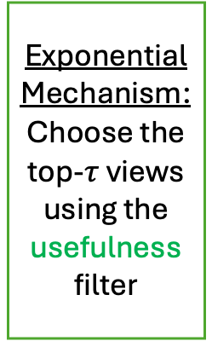
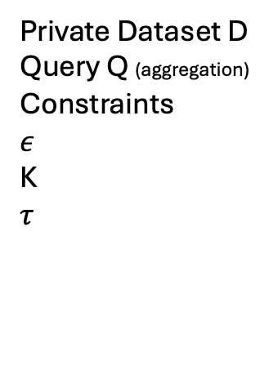

Privacy Analayzing using Composition Rules
$$\left(A_{1}, best histogram, noisy score\right)$$
$$\left(A_{2}, best histogram, noisy score\right)$$
…
$$\left(A_{k}, best histogram, noisy score\right)$$
Exponential Mechanism:
Choose the top-$τ$views using the usefulness filter
$$∀A∈Attrs$$
Exponential Mechanism:
Choose the best view using HD
Find the top-K scored attributes and generate noisy histograms
Private Dataset D
Query Q (aggregation)
Constraints
$$ε$$
K
$$τ$$
Views generation using predicates
Refinement Algorithm
Q’
…
Constraint attr
Generate noisy histogram
$$privacy budget=τ×\frac{ε}{2τ}+\frac{ε}{2}=ε$$

Slide 36
Privacy Analayzing using Composition Rules
$$\left(A_{1}, best histogram, noisy score\right)$$
$$\left(A_{2}, best histogram, noisy score\right)$$
…
$$\left(A_{k}, best histogram, noisy score\right)$$
Exponential Mechanism:
Choose the top-$τ$views using the usefulness filter
$$∀A∈Attrs$$
Exponential Mechanism:
Choose the best view using HD
Find the top-K scored attributes and release noisy histograms
Private Dataset D
Query Q (aggregation)
Constraints
$$ε$$
K
$$τ$$
Views generation using predicates
Refinement Algorithm
Q’
…
Constraint attr
Generate noisy histogram
$$privacy budget=τ×\frac{ε}{2τ}+\frac{ε}{2}=ε$$

Slide 37
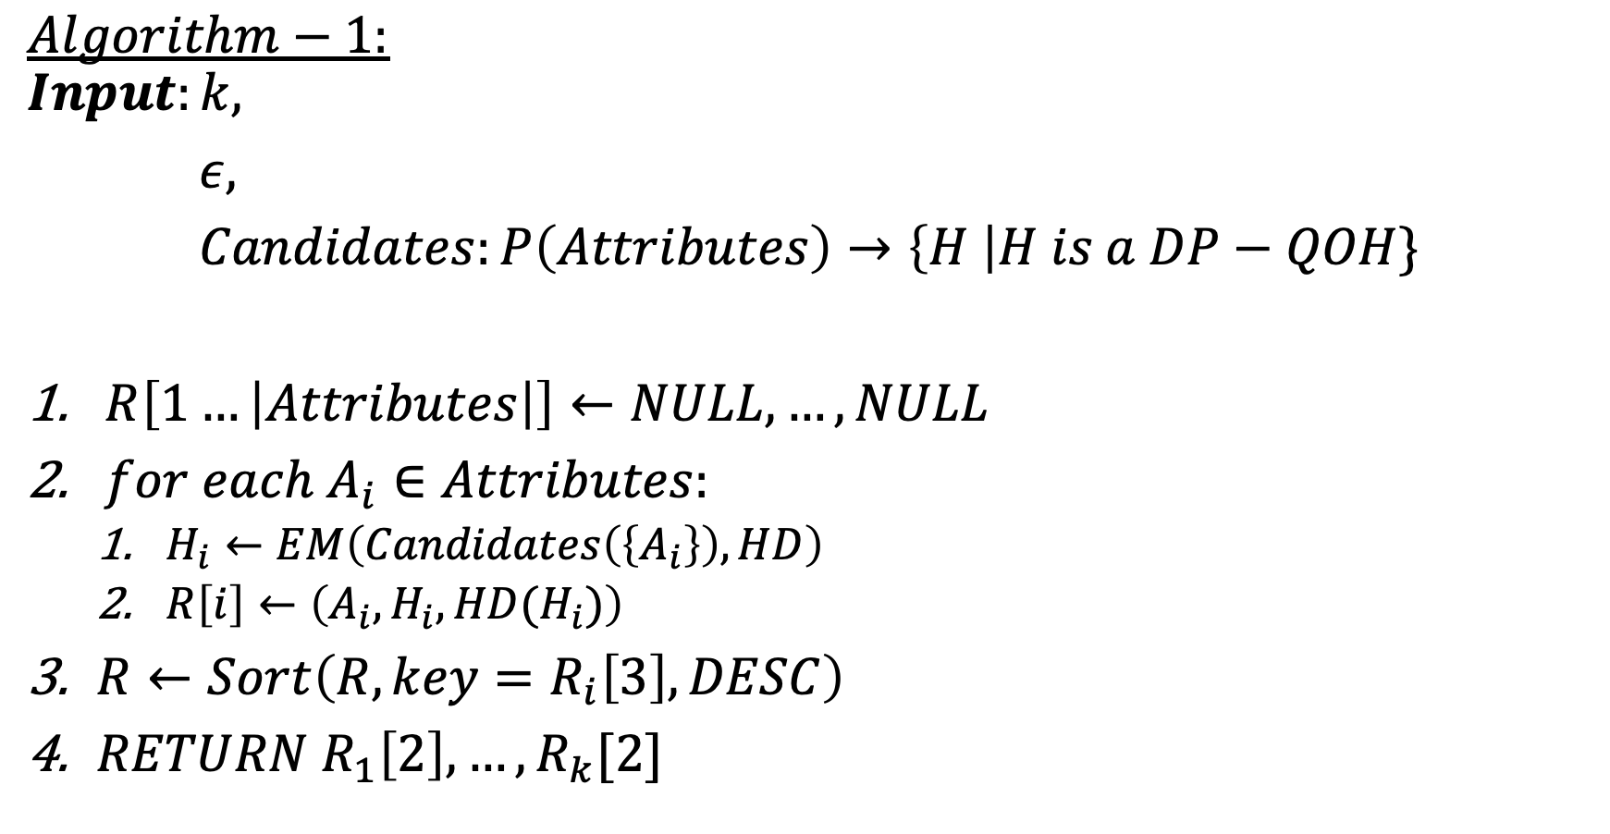
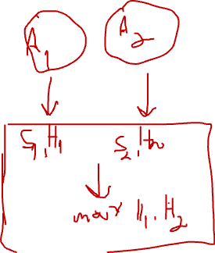
$$Algorithm−1:$$
$$Input:k,$$
$ε,$
$Candidates:P\left(Attributes\right)→\left\{H \right|H is a DP−QOH\}$
$R\left[1…\left|Attributes\right|\right]←NULL, …,NULL$
$for each A_{i}∈Attributes:$
$H_{i}←EM\left(Candidates\left(\left\{A_{i}\right\}\right), HD\right)$
$R\left[i\right]←\left(A_{i},H_{i},HD(H_{i})\right)$
$R←Sort\left(R, key=R_{i}\left[3\right], DESC\right)$
$RETURN R_{1}\left[2\right],…,R_{k}[2]$

Slide 38
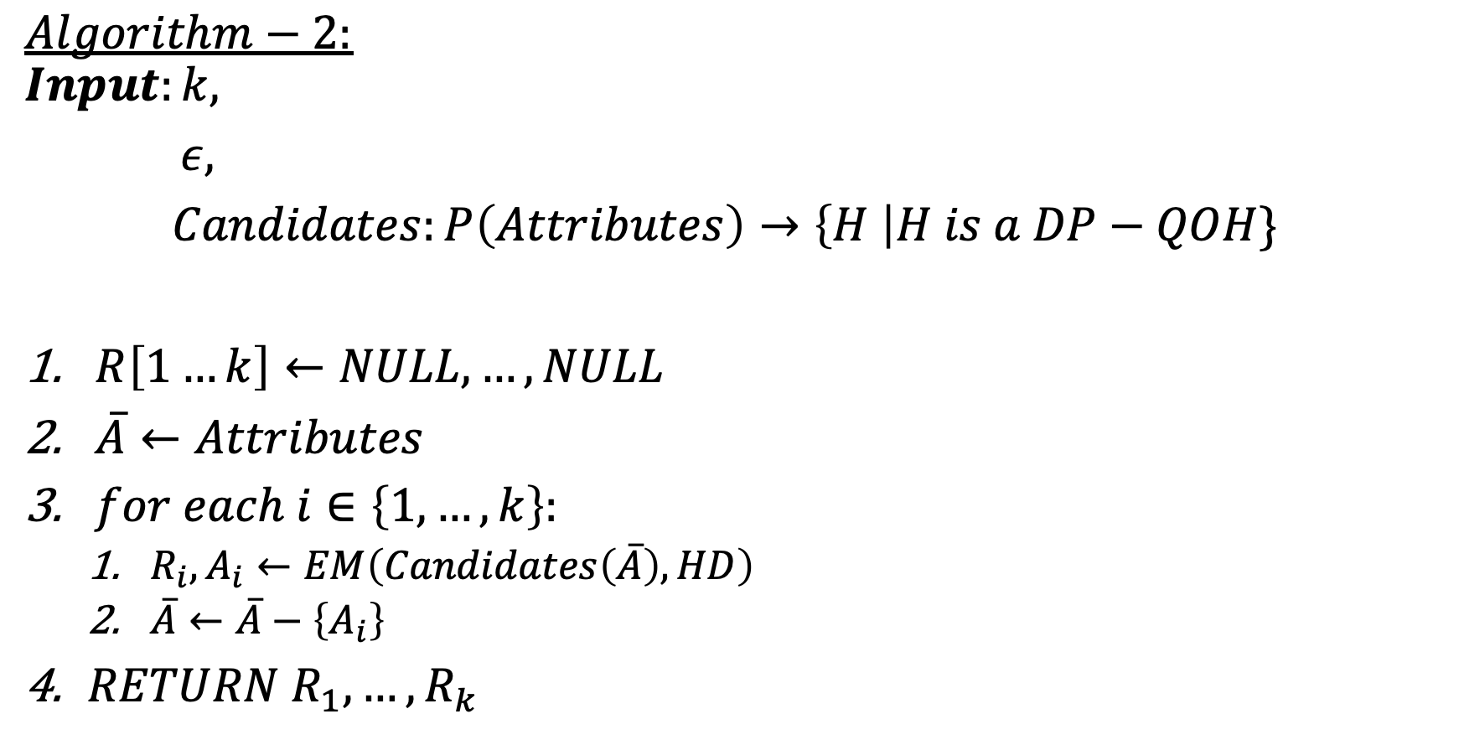
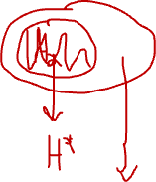
$$Algorithm−2:$$
$$Input:k,$$
$ε,$
$Candidates:P\left(Attributes\right)→\left\{H \right|H is a DP−QOH\}$
$R\left[1…k\right]←NULL, …,NULL$
$\overline{A}←Attributes$
$for each i∈\left\{1,…,k\right\}:$
$R_{i}, A_{i}←EM\left(Candidates\left(\overline{A}\right), HD\right)$
$\overline{A}←\overline{A}−\left\{A_{i}\right\}$
$RETURN R_{1},…,R_{k}$

Slide 39
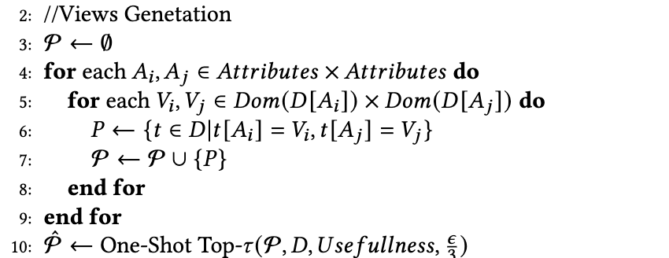

Views Generation Strategy
Alternative:
Give each tuple log (|Attrs|) tokens
Score each View by noisy Usefulness score
Run greedy algorithm for choosing views(according to Usefulness Score) which $∀t∈View, tokens\left(t\right)>0$ and reduce tokens properly.

Slide 41
Experiments
Default Setting
K | Tau | epsilon | Predicates | # of trials
3 | 50 | 1 | All combinations of A1=v1 and A2=v2 | 10
data | queries | Semantic difference | explanations
IPUMS-CPS (Down sampled to 100,000 tuples) | Q1,1: EMPSTAT = 'Employed’ AND UHRSWORK >= 35 Q1,2: EMPSTAT = 'Employed’ AND UHRSWORK < 35 | Full time job VS part time job | UHRSWORK, SEX, AGE, EDUC, INCTOT
 | Q2,1: EMPSTAT = 'Employed’ AND EDUC >= 'Bachelor''s degree' Q2,2: EMPSTAT = 'Employed’ AND EDUC < 'Bachelor''s degree' | Employed people With or without higher eductation | SEX, AGE, EDUC, INCTOT, RACE
 | Q3,1: EMPSTAT = 'Employed’ AND INCTOT >= 60000 Q3,2: EMPSTAT = 'Employed’ AND INCTOT < 30000 | People with high income VS low income | SEX, AGE, EDUC, INCTOT, RACE
Stack-Overflow survey | Q4,1: YearsCodePro >= 10 Q4,2: YearsCodePro < 4 | Professional VS non-professional | DevType, CodeLanguage
 | Q5,1: WorkRemote = "Fully remote" Q5,2: WorkRemote = ”On-Site" | Remote Workers vs On-site Workers | DevType, Country, YearsCodePro, CompanySize
 | Q6,1: Satisfaction > 5 And UsingAI = “yes” Q6,2: Satisfaction > 5 And UsingAI = “no” | The impact of using AI tools on satisfaction | DevType, CodeLanguage, YearsCodePro, Country

Slide 42
Experiments
Scalability
Runtime = f(#tupels)
By down sampling
Runtime = f(Algorithm)
Algorithm = Private-Explanations / Brute-Force / Brute-Force with non-proxy utilities
Runtime = f(k)
Runtime = f(#Predicates)
Runtime = f(epsilon)
Runtime = f(tau)

Slide 43
Experiments
Quality measures
For each dataset, generate an hitmap of the output histograms by:
Set of initial predicates
Tau
Algorithm (Privacy impact)
Algorithm = Private-Explanations / Brute-Force / Brute-Force with non-proxy utilities
Epsilon (Privacy impact)
 | EDUC=1 | EDUC=2 | EDUC=12
SEX | 1 | 8 | 1
AGE | 4 | 0 | 3
RACE

